Slide 1
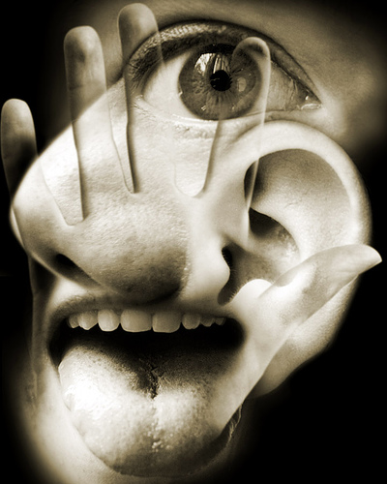
The Sense Organs
Anthony’s Textbook of Anatomy & Physiology:
Chapter 15

Slide 2
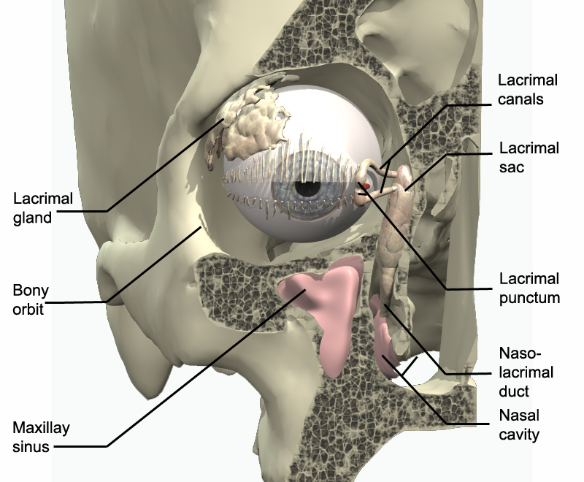
Vision: Structure of the Eye
Lacrimal apparatus:
Lacrimal gland: produce tears that wash down over the eyes to cleanse them.
Nasolacrimal duct: canal in the corner of the eye that drains tears to nasal cavity

Slide 3
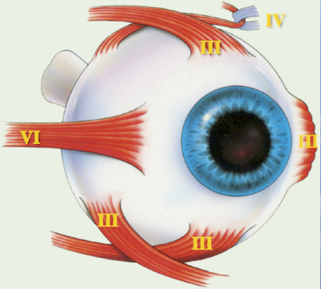
External Eye Muscles:
Rectus Muscles: move the eyeball up, down, left, or right
Oblique Muscles: twist the eyeball

Slide 4
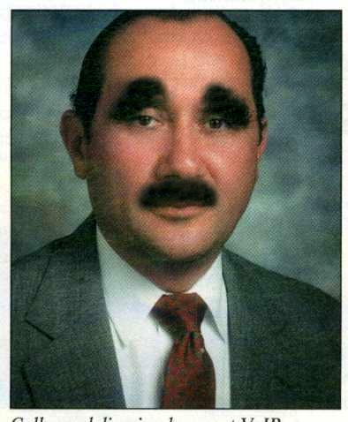
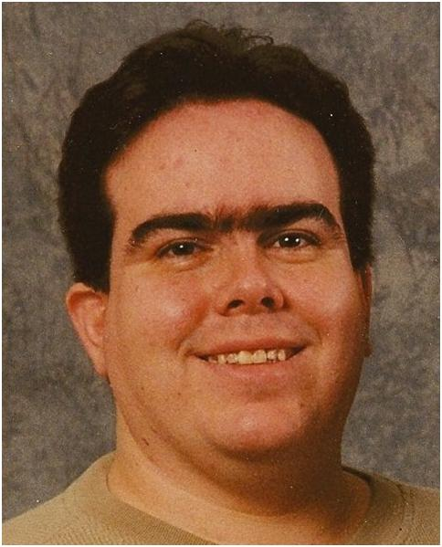
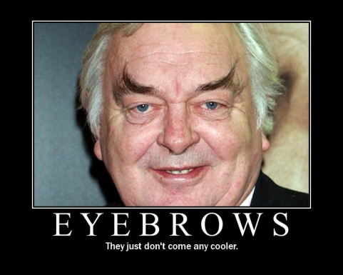
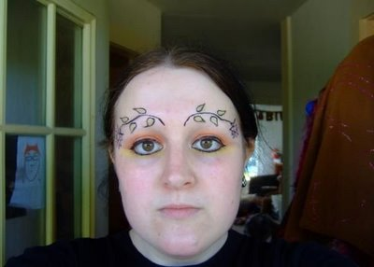
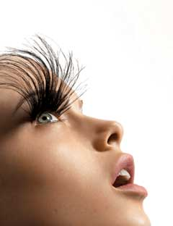
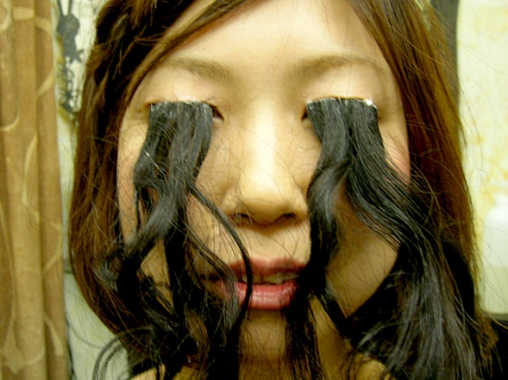
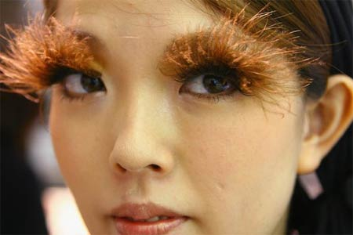
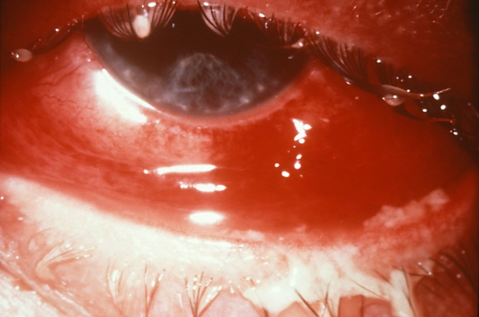
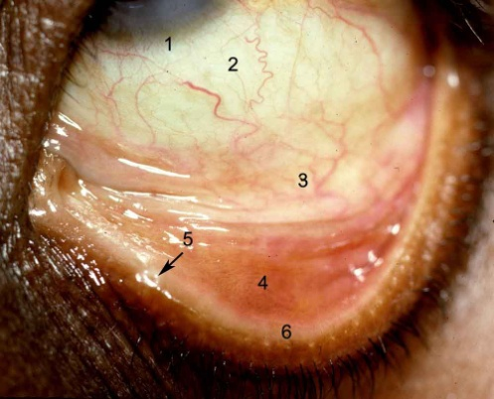
External Accessories:
Eyebrows: protect the eyes from dirt and sweat. Provide some shade from intense light
Eyelashes: same as brows. Tiny glands at their base secrete an oily lubricant.
Conjunctiva: thin mucous membrane lining the eyelids and outer eyeball.

Slide 5
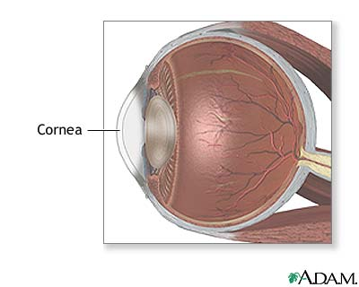
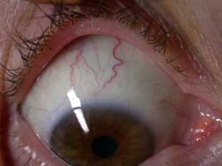
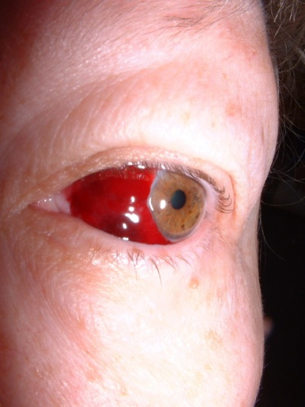
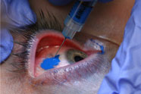
Outer Coat (Fibrous Layer):
Cornea: The transparent region at the anterior of the eye. No blood vessels.
Sclera: The “whites” of the eyes. The outer coat which contains blood vessels.

Slide 6
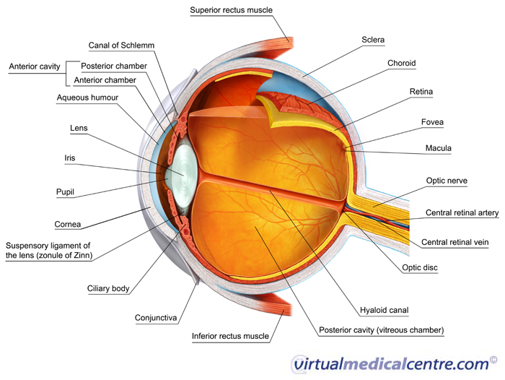
Middle Coat (Vascular Layer):
Choroid: Highly vascular middle layer of the eye.
Lens: refracts light
Suspensatory Ligaments: connect ciliary muscle to lens
Ciliary Muscles: Muscles that change shape of lens to adjust focus

Slide 8
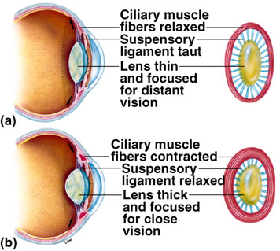
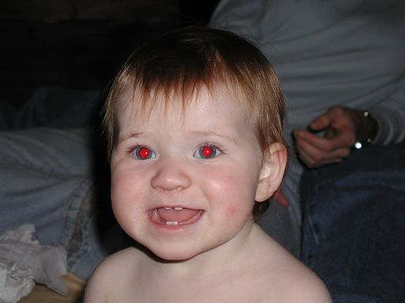
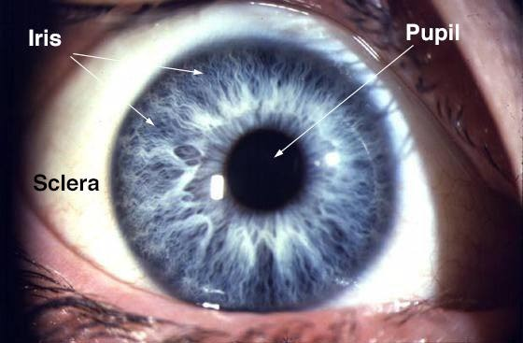
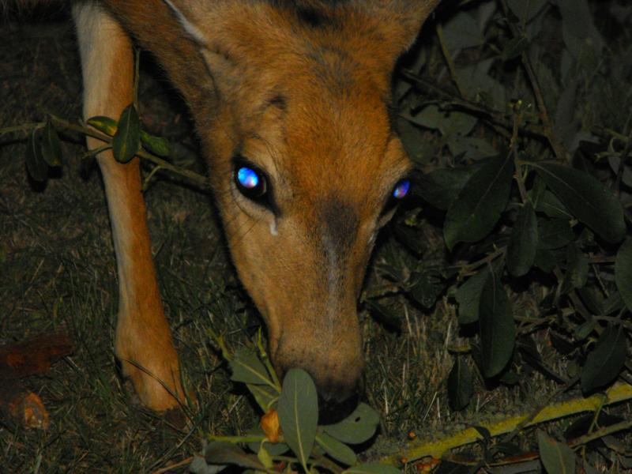
Accommodation= focusing by changing the shape of the lens
Pupil: opening for light entry. Its size adjusts according to available light.
Iris: The colored part of the eye. Made of smooth muscle to dilate or constrict the pupil.

Slide 9
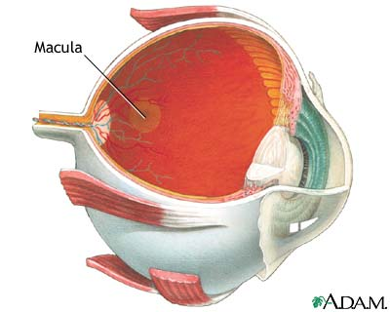
Inner Coat:
Retina: innermost coat at the back of the eyeball. It contains the sensory photoreceptors, rods and cones. It is continuous with the optic nerve.
Fovea: a small indent in the retina where cones are very thick. Vision is sharpest here.
Macula: yellowish spot at the back of retina that contains the fovea
Optic disc: where the optic nerve and blood vessels leave/enter the eye. Creates a blind spot on the retina.
Optic nerve: carries sensory info to the brain.

Slide 10
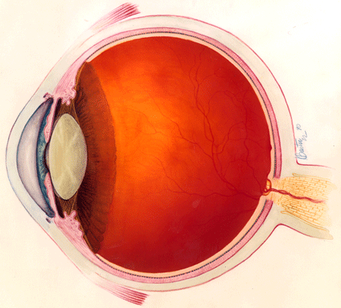
Cavities and Humors:
Posterior Cavity:
Large central cavity behind the lens. It contains the thick, jelly like vitreous humor.
Anterior Cavity:
space between the cornea and lens. It contains the watery aqeous humor which circulates to bring oxygen and nutrients to the cornea.

Slide 11
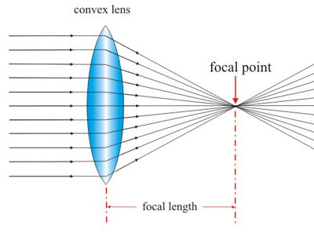
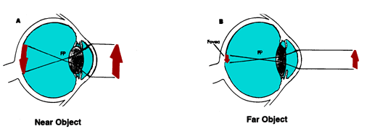
Vision: The Process of Seeing
4 processes needed for a proper image on the retina:
1. Refraction:
bending of light rays
to converge at a focal
point.
2. Accomodation:
change of lens shape
according to distance
of the object

Slide 12
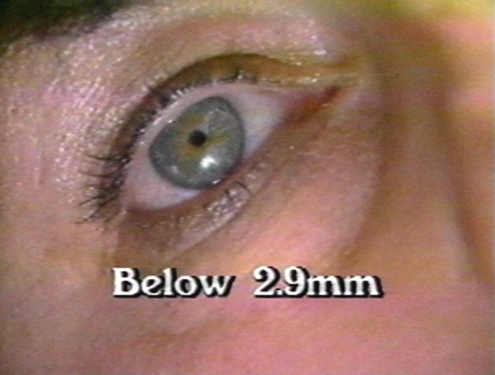
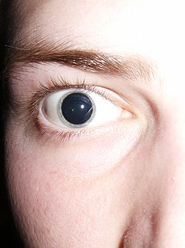
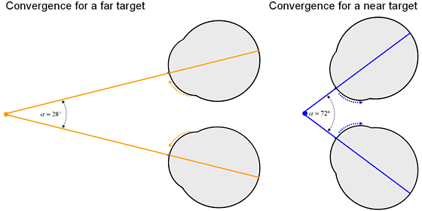
3. Constriction of pupil:
Necessary for near vision or in excessive light.
4. Convergence of eyes:
Inward angling of the eyes so they both aim at an object. Convergence increases when an object gets closer.

Slide 13
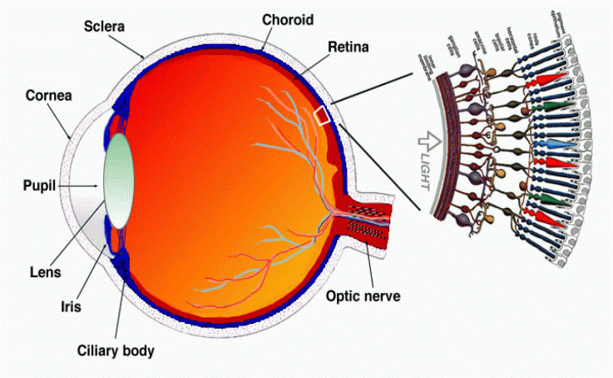
Role of photopigments-
Photopigments- chemical compounds that undergo change when exposed to light. They’re found in photoreceptor cells of the retina, rods and cones. The chemical change of the photopigment causes an action potential in the receptor cell which travels to the brain (sensation).

Slide 14
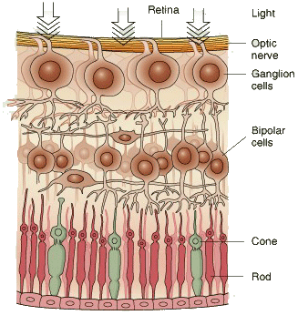
Role of photoreceptors-
Photoreceptors are actually found at the back of the retina behind the nerve cells that carry their sensory signals to the brain.
NERVE SIGNAL
LIGHT
Rods- are very sensitive to light. Only need low light. The brain does not interpret any color from rods, only monochrome or “black and white”.

Slide 15
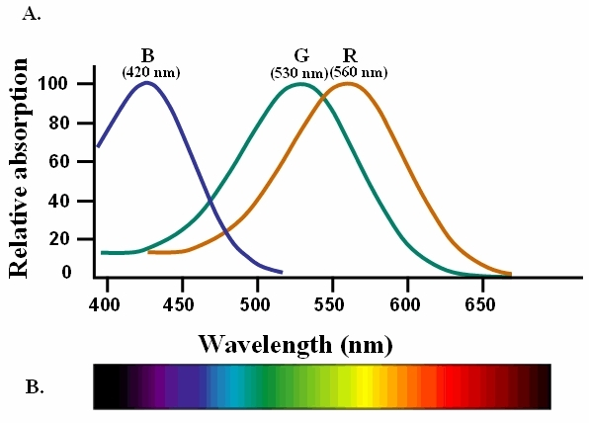
Role of photopigments-
Cones- 3 kinds either sensitive to red, green, or blue, wavelengths of light. Our range of color vision comes from a mixture of inputs from the 3 types. Only work well in bright light.

Slide 16
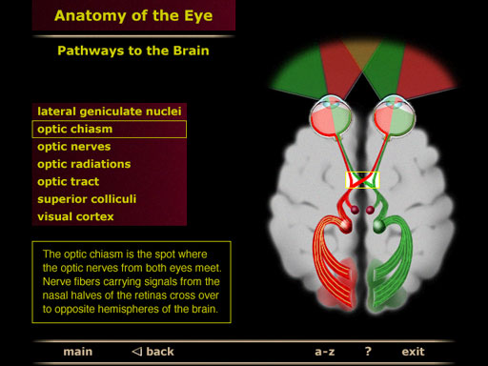
Neural Pathway of vision-
Visual information leaves the photoreceptors of the retina via the optic nerve. The optic nerves from each eye meet near the center of the brain and continue to the back of the brain. Some info from the right eye is interpreted on the left side of the brain and vice versa.

Slide 17
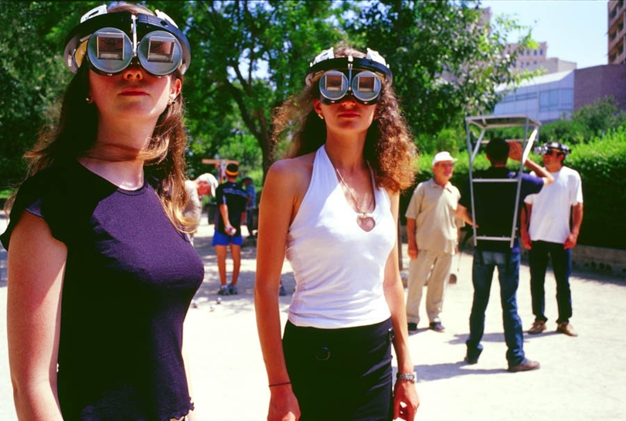
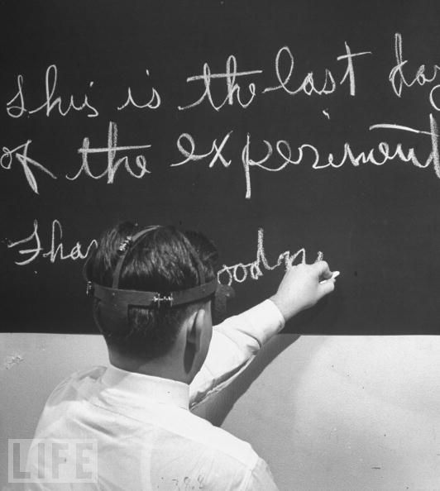
Neural Pathway of vision-
The brain does a lot of work to interpret visual info, (perception) such as putting together shapes, movements, textures, and colors, as well as the image right side up.

