Slide 1
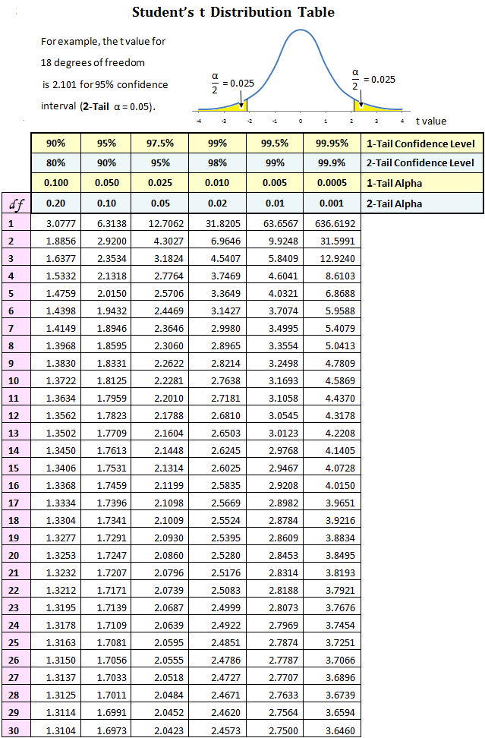
6.1.6- “T-tables”
6.1.6- Deduce the significance of the difference between two sets of data using calculated values for t and the appropriate tables.

Slide 2
The t-test can be used to measure whether there is a significant difference between the means of two sets of data or if the difference is merely random.
The calculated value of “t” by itself is not very important but it is used to find “p” which IS very important
p stands for “probability”. It is the probability that the differences in data are random or simply by chance

Slide 3
SO, for the difference in sets of data to be SIGNIFICANT (not simply random), we would need to have a LOW p value.
How low you ask? Scientists have generally agreed on an objective p value of <.05 as the cut off value
This means a less than 5% chance that the differences in data are caused by random chance

Slide 4
Here is a brief video explaining T-tests. (it’s a bit dry but we’ll just look at the first 5 minutes stopping occasionally to discuss) Youtube- What is a T-test?
Let’s take a minute to refer back to our NFL combine article from last class. Take a look at the abstract again. What do the p values mean to you now?

Slide 5
Types of T- tests:
Paired Test- Either the same people are being tested multiple times, or people who are “paired” into a group according to a particular trait (wgt., age, etc.)
Unpaired Test- data from groups of people are compared because they are different.

Slide 6
Practical Application – (reaction time continued)
We will now use our reaction time sticks again to collect data and perform a t-test of your own
We will compare reaction time after “Mindful Preparation” and during “Moderate Physical Exercise”
First, in your table group of 3, decide who will be the test administrator, who will be the subject, and who will be the data recorder.
Review procedure from last time

Slide 7
Procedure:
1. I will lead the class in a brief mindfulness exercise prior to the first round of reaction time tests (same testing procedure as last time, 30 trials)
2. Collect and record data
3. For part 2, the subject will jog in place or do jumping jacks or burpees for 2 minutes to increase heartrate. Three reaction time trials will be taken. The subject then does jumping jacks or jogs for ten seconds. Three more trials are taken. Repeat alternating exercise and reaction time trials until 30 trials have been recorded.
POSSIBLE ERRORS?

Slide 8
Calculating your t-table
By 1:50 pm your group MUST:
Compile data using Excel, Google Sheets, or other, just as you did with our last experiment. Calculate and display the mean, SD, and V as before for these 2 new data sets.
Next use t-table calculations to find the p value for the 2 data sets (see below)
Google “Online T test”
Select GraphPad QuickCalcs: t test calculator
Alternatively, follow this link to a YouTube video for how to do a t-test in Excel
https://youtu.be/voeE-W5yWZQ

Slide 9
Correlation-
Can show if 2 sets of data have a negative, or positive relationship, or no relationship at all.
The correlation coefficient, r , tells you how well one variable can be predicted by another variable
How close is a scatter plot to being a linear relationship?
r is on a scale between +1 and -1
r=+1 or r=-1 indicates a PERFECT linear relationship
r= .5 or -.5 indicates moderate relationship, r=0 is no relationship
Spreadsheet software will calculate r as well as many online stats calculators
NFL COMBINE EXAMPLE
CORRELATION DOES NOT MEAN “CAUSE”! Video: video

