Slide 1
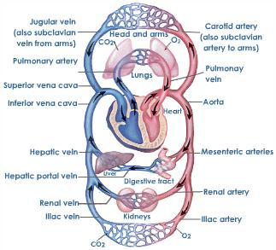

The Circulatory System

Slide 2
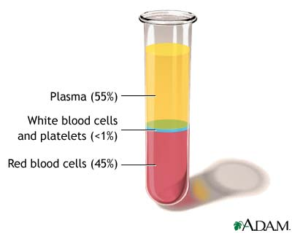
Blood and Blood Vessels-
Blood= 55% plasma
=90% H₂O, 7% proteins, 3% dissolved salts, etc.
45% formed elements
= rbc’s (~98%), wbc’s, and platelets

Slide 3
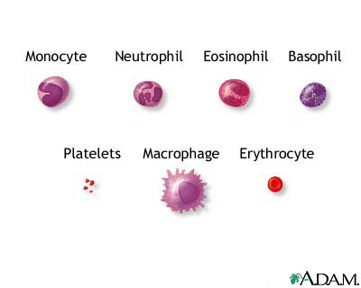
-RBC’s (erythrocytes) – contain hemoglobin that carries O₂ to cells and CO₂ away
-WBC’s (leukocytes) – 5 types all involved in fighting infection
-platelets – (thrombocyte cell fragments) not living, responsible for clotting

Slide 4
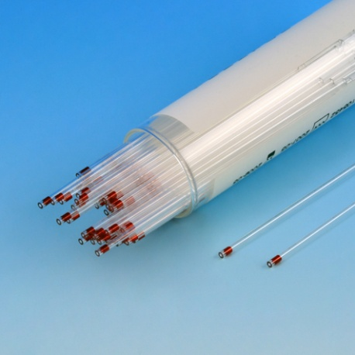
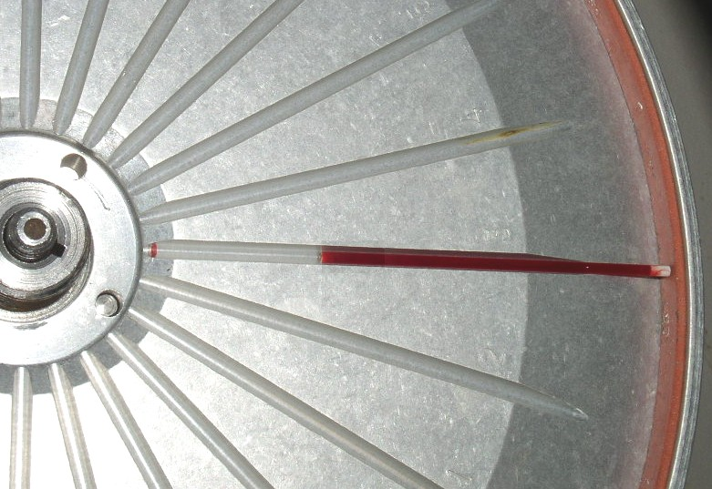
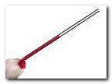
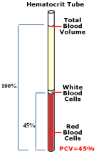
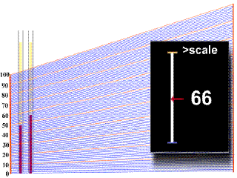
Basic tests for blood make-up:
Hematocrit- spin down blood to see % of RBCs
Low=anemia High=polycythemia

Slide 5
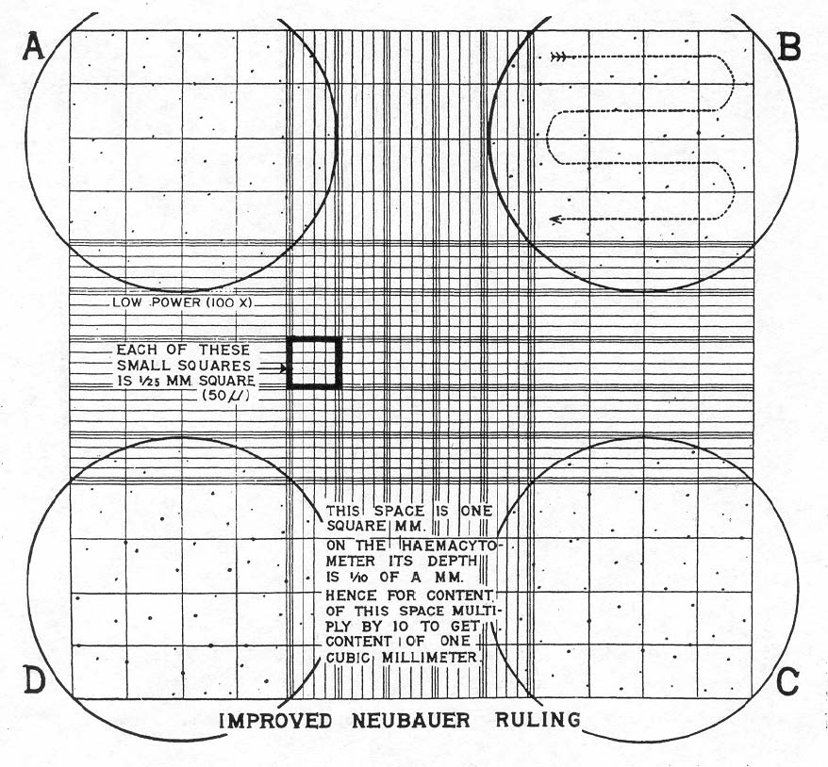
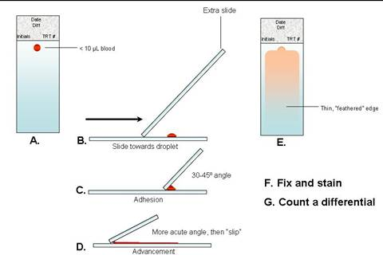
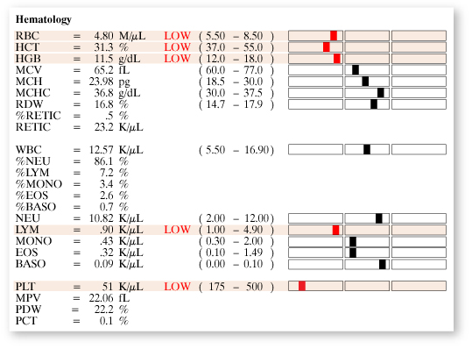
Complete blood count with differential (CBC w/ Diff.) – observation of # and type of cells in a sample
2.
1.
3.

Slide 6
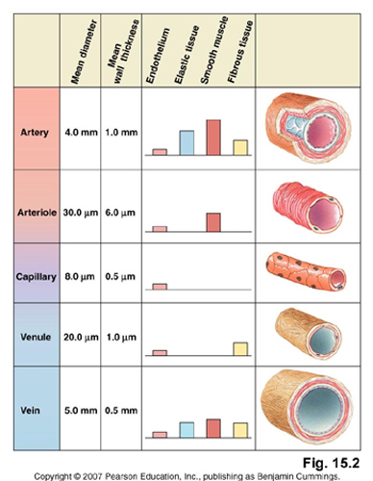
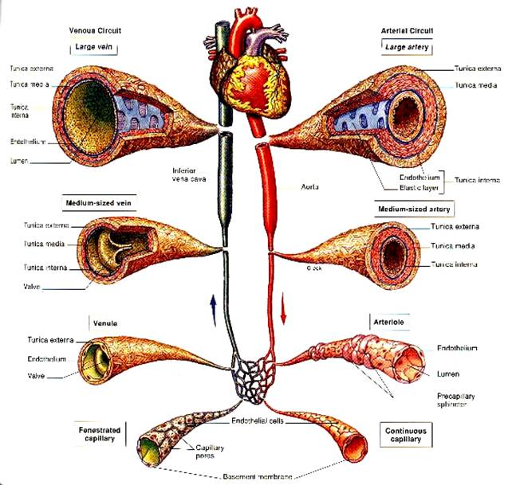
Blood Vessels Types:
Aorta
Arteries
Arterioles
Capillaries
Venules
Veins
Vena cava

Slide 7
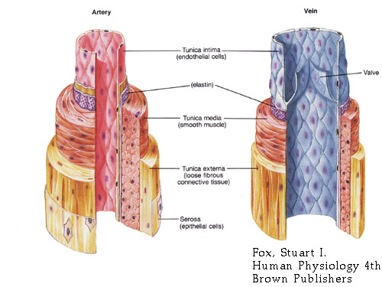
Arteries= AWAY from heart - high pressure - “elastic”
Veins= carry blood TO heart - low pressure - have valves to keep blood from reversing

Slide 8
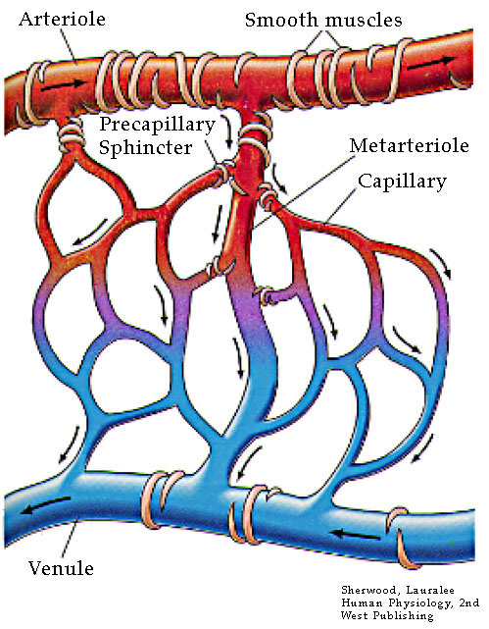
Capillaries= TINY vessels (wall is 1 cell thick)
-where gases (O₂ & CO₂) and materials are exchanged with tissues
- transition between arterial and venous circulation

Slide 9
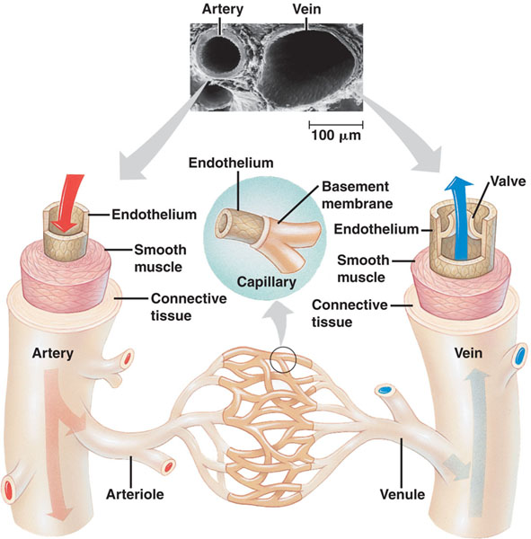
Comparison of Arteries and Veins:
Arteries | Veins
Thick walled | Thinner walls
Generally Larger Diameter | Slightly smaller diameter
Deep | Superficial (closer to skin)
Much smooth muscle | Less muscle
Quite elastic | Less elastic
No valves | Valves

Slide 10
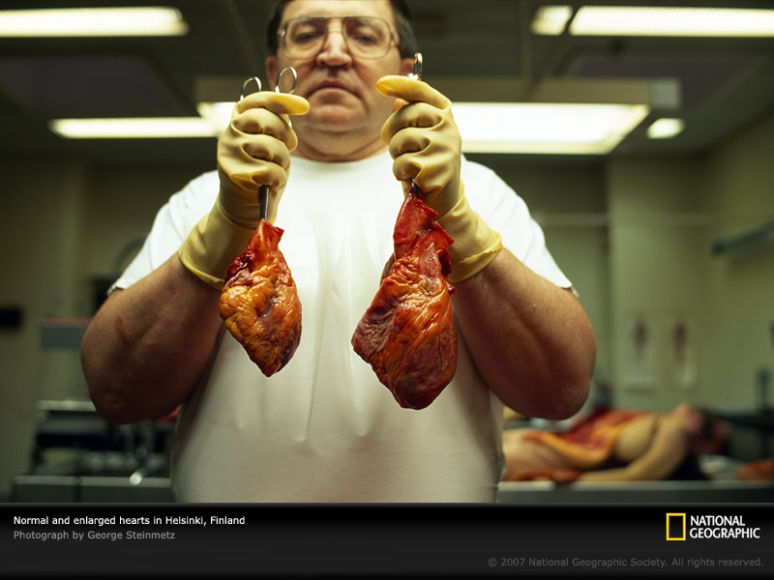
Anatomy of the Heart

Slide 11
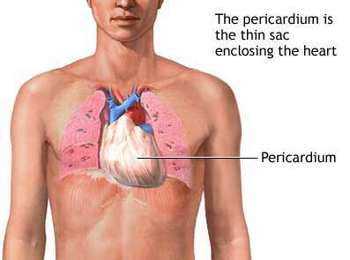
Pericardium- A tough double walled sac that surrounds the heart.
  Protects the heart from infection
  Fluid between layers of pericardium allow for nearly friction free movement

Slide 12
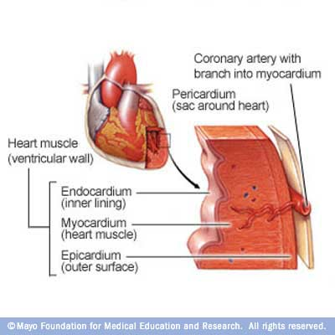
Coronary Vessels- on the outside of the heart and bring blood to/from heart muscle
Myocardium- the actual muscle of the heart
Endocardium- the inner epithelial lining of the heart chambers

Slide 13
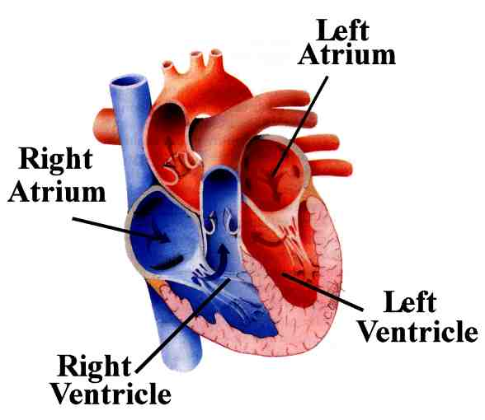
Heart Chambers
  Left and right atrium (atria)- small upper chambers receiving blood to the heart.
    Left= from pulmonary vein Right= from vena cava
  Left and right ventricle(s)- large muscular chambers pushing blood out of the heart.
    Left= to body via the aorta right= to lungs via pulmonary artery

Slide 14
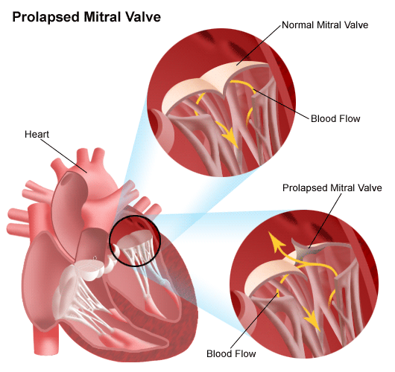
Heart Valves- allow blood flow in only 1 direction
  AV (atrioventricular) valves= between atria and ventricles
    Right AV= tricuspid valve left AV= mitral valve
    Attached to small papillary muscles via the chordae tendinae (“heartstrings”) that help pull them CLOSED when the ventricles squeeze

Slide 15
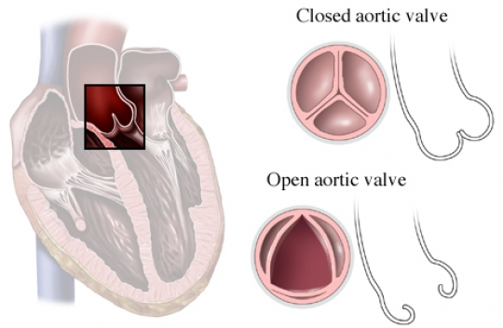
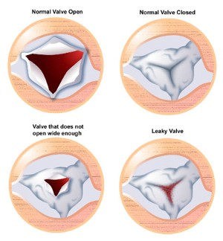
  Semilunar valves= (semi-moon shape)
    Left= aortic right= pulmonary
    OPEN when ventricles squeeze to let blood out

Slide 16
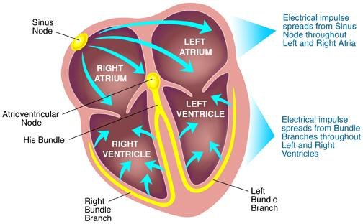
Conduction System of the Heart-
-Heart beat is intrinsic meaning no signal from the brain is actually needed!
Heart muscle cells will contract by themselves, when together they start to contract at the same time.
However, nerve and hormonal (extrinsic) signals do alter its rate

Slide 17
4 main parts to the heart’s electrical system:
  Sinoatrial or SA node-
    Heartbeat starts here in upper Rt atrium (the hearts pacemaker)
    Causes the atria to contract
SA Node

Slide 18
  AV (atrioventricular node)- in center of heart
    After atria contract completely, this controls contraction of ventricles.
AV Node

Slide 19
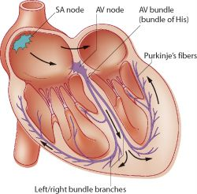
  “Bundle of His” and 4. Purkinje fibers
    Transmit the stimulus to the both ventricles so they contract simultaneously
Bundle of His
Purkinje Fibers

Slide 20
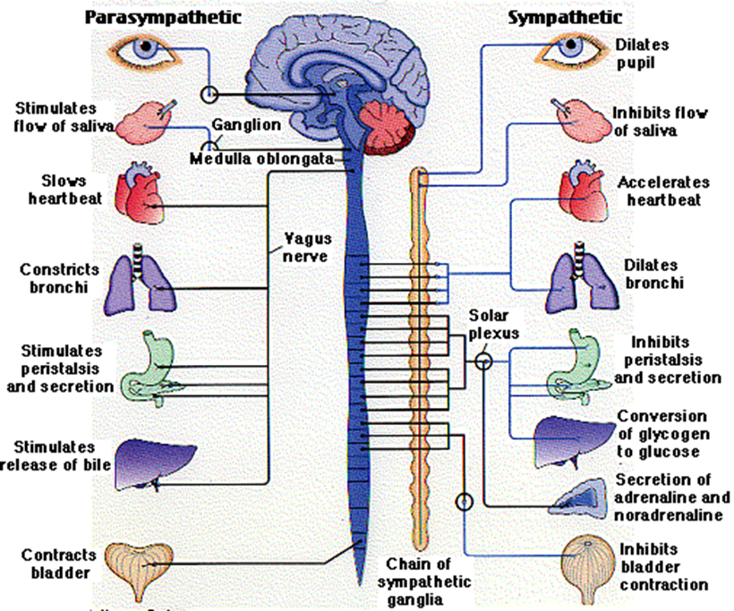
Extrinsic Control of Heartrate-
Autonomic (Involuntary Nerves) effect rate of pacemaker
  Sympathetic (“fight or flight”) nerves speed up h.r.
  Parasympathetic (“rest & repair”) slow down h.r.
Hormomes (ex.- adrenaline) and drugs will effect the autonomic nerves and thus heartrate

Slide 21
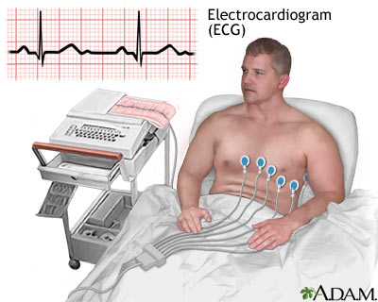
Electrocardiogram (ECG)-
A graphic record of the heart’s electrical activity
electrodes on the skin sense the movement of electric signal through the heart during heartbeat
only need 3 electrodes but 12 are used for best quality ECG

Slide 22
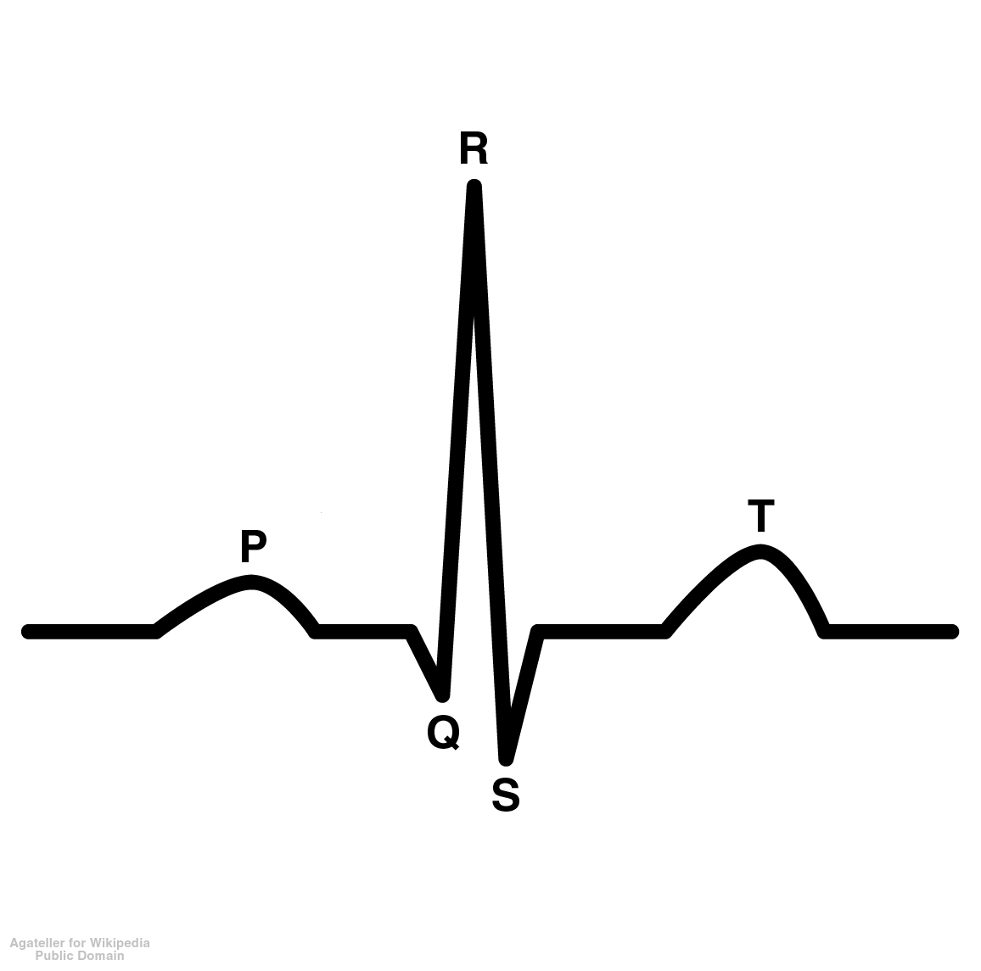
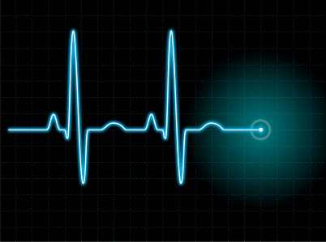
the “waves” of an ECG are lettered P through T
P wave= squeezing of the atria
QRS complex= relaxing of atria and squeezing of ventricles
T wave= relaxing of ventricles, heart back to rest

Slide 23
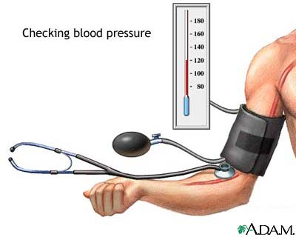
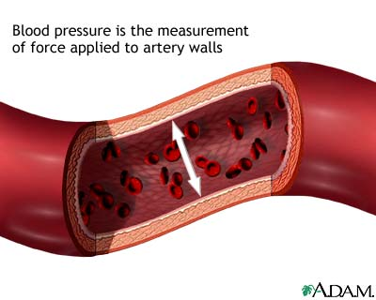
Blood Pressure-
Blood Pressure- pressure of blood pushing on vessel walls
  Systolic= pressure when heart ventricles squeeze
Diastolic= pressure when heart is at rest
Avg. B.P.=120/80
Pressure is HIGHEST in aorta and major arteries
Pressure is very LOW in veins= <10 mmHg

Slide 24
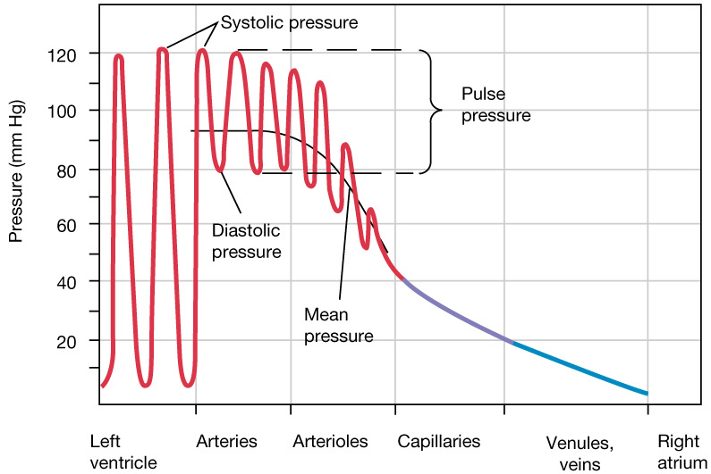
More Blood Pressures:
Pulse and Mean Arterial Pressures
Pulse pressure = Systolic - Diastolic
Mean arterial pressure (MAP) = Diastolic +
1/3 pulse pressure

Slide 25
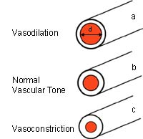
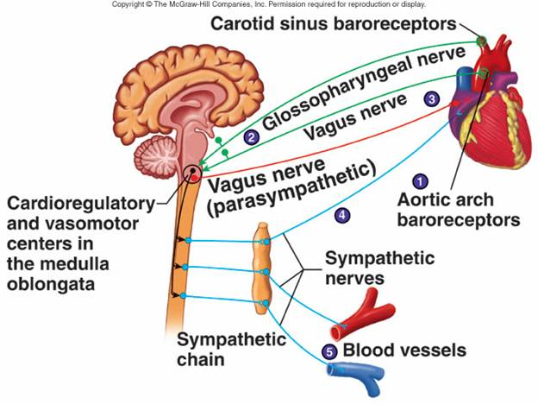
Regulation of Blood Pressure:
4 THINGS that can change and effect pressure:
Arteries can dilate or constrict
(achieved by smooth muscles surrounding the vessel)
Heartrate
Total Blood Volume
-hydration
-blood loss
Stroke volume (amount
  of blood in each
  heartbeat)

Slide 26
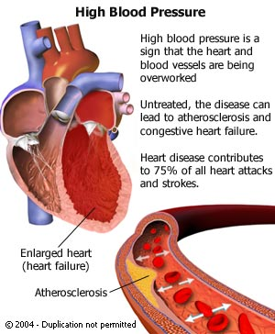
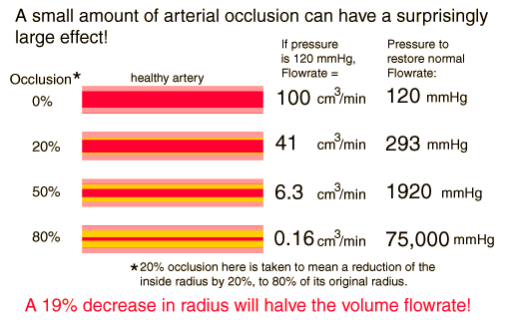
High b.p.=may be caused by narrowing &/or hardening of the arteries (atherosclerosis)

Slide 27
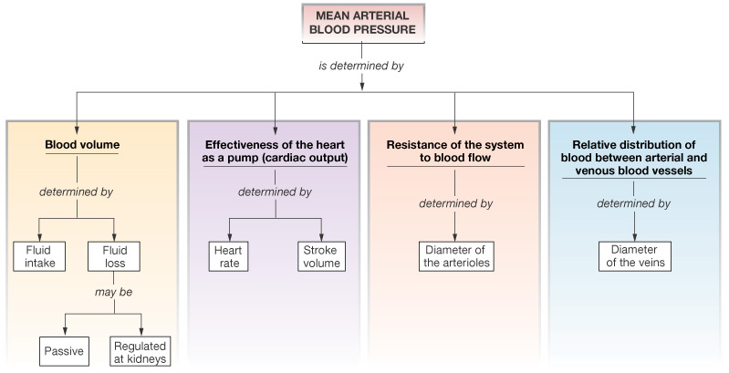
Factors Controlling MAP :
The Driving Pressure for Blood Flow
Figure 15-10: Factors that influence mean arterial pressure

Slide 28
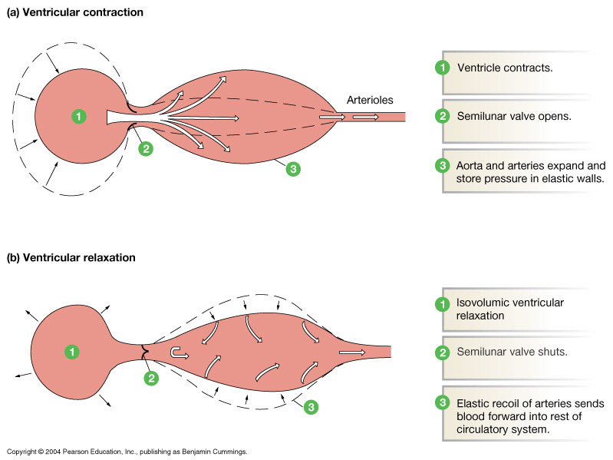
Blood Pressure:
Generated by Ventricular Contraction
Figure 15-4: Elastic recoil in the arteries

Slide 29
Blood Pressure (BP): Measurements
"Blood pressure"
  Systolic over diastolic
  About 120/80 mmHg
Sphygmomanometer
  "Estimate of pressure"
  Korotkoff sounds (see next slide)
PLAY
Animation: Cardiovascular System: Measuring Blood Pressure

Slide 30
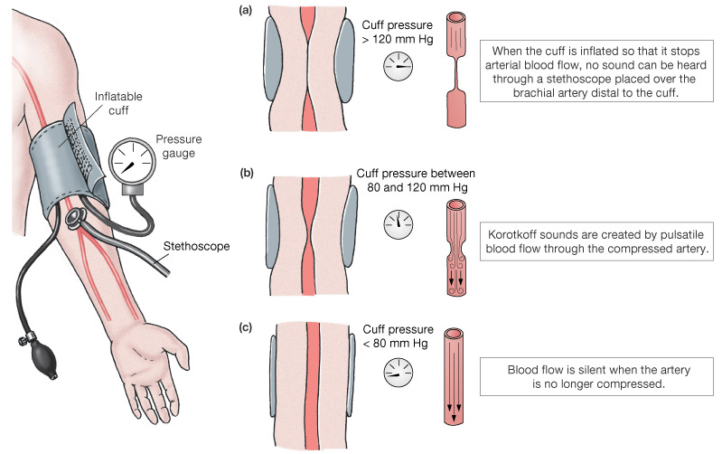
Blood Pressure (BP): Measurements
Figure 15-7: Measurement of arterial blood pressure

Slide 31
Blood Pressure response to exercise
Blood Pressure increases in response to exercise
  The effect is greater in static exercise (i.e.-heavy lifting) than dynamic (movement like running)
  In dynamic exercise the diastolic pressure DOES NOT increase significantly but systolic does

Slide 32
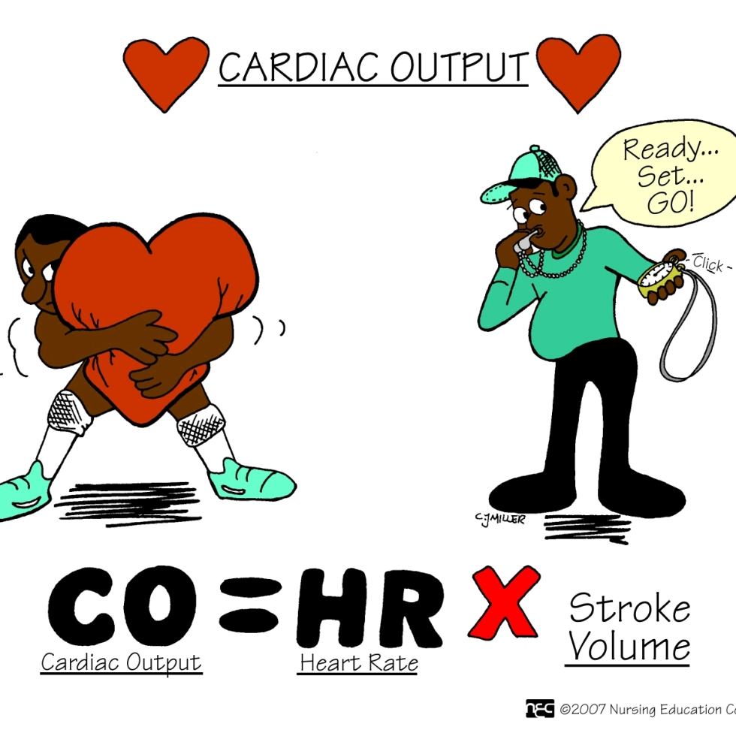
Cardiac Output
Cardiac Output= stroke volume x heartrate
  C.O. must increase during exercise
  BOTH stroke volume and h.r. go up
Conditioned athletes= have greater stroke volume both at exercise AND rest
Children=
Smaller stroke volume

Slide 33
Distribution of blood during exercise:
Up to 90% of blood during exercise may go to the blood and heart. (compared to 25% at rest)
Achieved by change in diameter of blood vessels
Cardiac “Drift”:
During sustained exercise, more blood to skin to cool body causes stroke volume to slightly decrease
h.r. slightly increases to maintain cardiac output

Slide 34
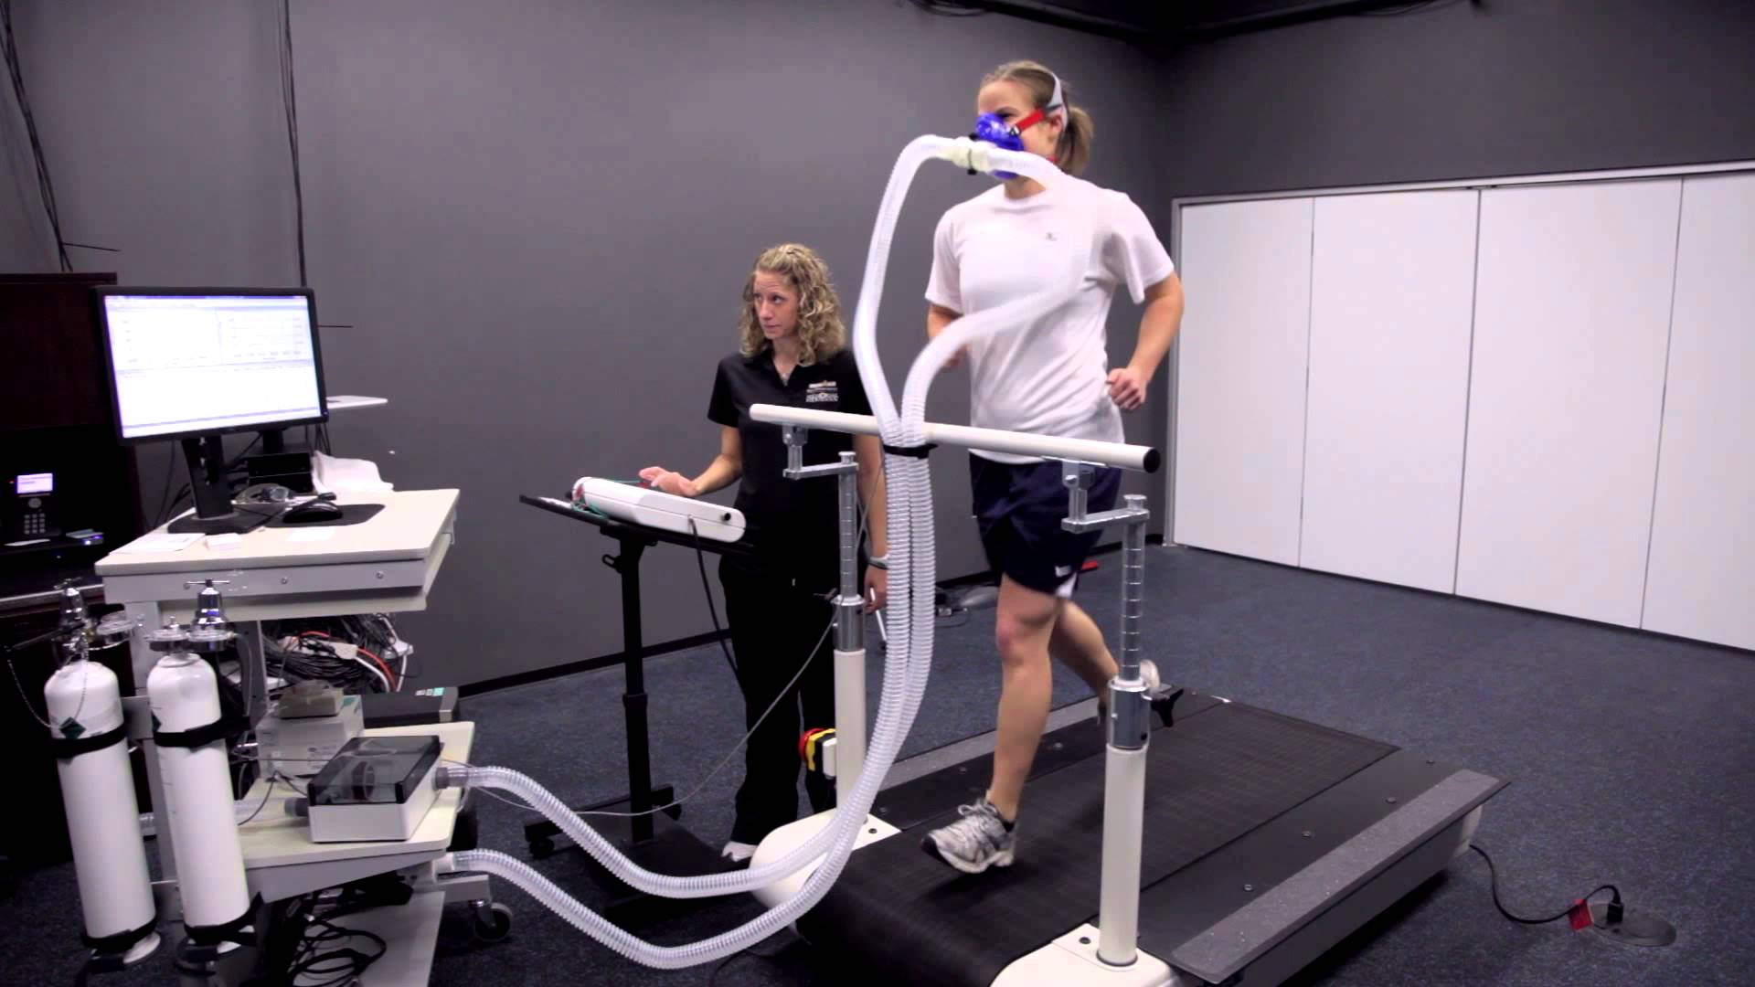
Maximal Oxygen Consumption (a.k.a. “Aerobic Capacity” or “VO₂ Max”
“VO₂” is the rate that oxygen taken into the body and used
Calculated by finding difference between oxygen content in arterial and venous blood and multiplying by cardiac output.

Slide 35
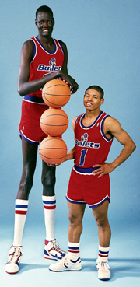
Absolute VO₂ Max is reported in liters/minute, (L/min)
However, relative VO₂ Max normalizes to account for body mass (smaller body mass means smaller absolute VO₂ Max)
Relative VO₂ Max is found by dividing by body mass, so it’s (liters/kg)/minute

Slide 36
Variability of Normalized VO₂ Max – (body mass taken into account)
Trained | Untrained
Higher | Lower
Due to increased stroke volume, development of more capillaries to muscle, changes in muscle physiology, changes in blood composition.
Male | Female
Higher | Lower
Even after accounting for body mass. Due to differences in body composition. Males have lower body fat %, higher muscle %
Children | Aged
Similar to adult when normalized | Lower
There is a gradual decline in maximum h.r. that can be achieved with age ☹

