Slide 1
Psychology of sport
Option B
https://www.youtube.com/watch?v=d8DSzLpEru0

Slide 2
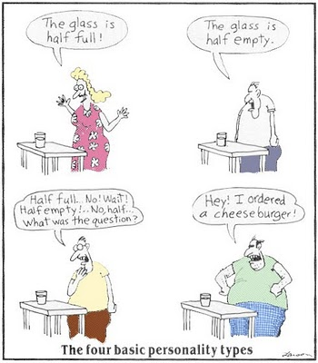
B.1.1 Define the term personality.
Those relatively stable and enduring aspects of individuals which distinguish them from other people, making them unique but at the same time permit a comparison between individuals.

Slide 3
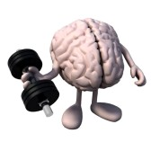
B.1.2 Discuss social learning theory and personality.
We have the capacity to learn through observation.
The personality components of the social learning theory are mainly cognitive:
Knowing
Being aware
Thinking
Learning
Judging

Slide 4
B.1.2 Discuss social learning theory and personality.
‘Personality is the sum total of an individual’s characteristics which make a human unique.’
(Hollander)
‘Personality represents those characteristics of the person that account for consistent patterns of behaviour.’
(Pervin, 1993)

Slide 5
B.1.2 Discuss social learning theory and personality.
How personality and social learning theory are related.
Competencies and skills
Beliefs and expectancies
Behavioral standards
Personal goals

Slide 6
B.1.2 Discuss social learning theory and personality.
Competencies and skills
Two implications:
Context specificity. Some psychological structures that are relevant in one situation may not be in another.
What might be an example?
Psychological change. Competencies are acquired through observation and social interaction.

Slide 7
B.1.2 Discuss social learning theory and personality.
1. Beliefs and expectancies
Beliefs are how thing are in our life (sport)
Expectancies are how things are going to be in the future and how they should be.

Slide 8
B.1.2 Discuss social learning theory and personality.
For change to occur in personalities the three factors of how we see the world, what we think will happen in the future and what the world should look like, must be addressed.

Slide 9
B.1.2 Discuss social learning theory and personality.
Behavioral standards
How we judge the goodness or worth of our behavior
We evaluate our own actions and then respond in an emotionally satisfied or dissatisfied way.
An internal guidance system.

Slide 10
B.1.2 Discuss social learning theory and personality.
Personal goals
A key concept to influencing change is identification and realization of ones goals.

Slide 11
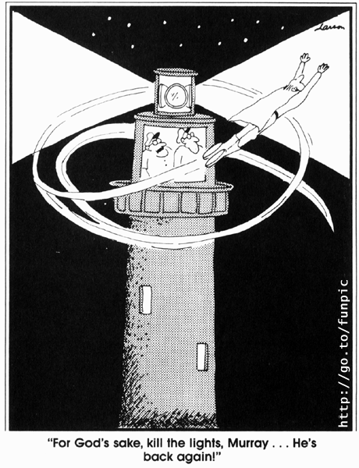
B.1.3 Discuss the interactionist approach to personality.
Behavior = Function of Personality x Environment
(B = F (P x E))
http://www.pearsonschoolsandfecolleges.co.uk/

Slide 12
B.1.3 Discuss the interactionist approach to personality.
Personality has three levels that interact to form personality
1 Psychological core
2 Typical responses
3 Role-related behaviour
http://www.pearsonschoolsandfecolleges.co.uk/

Slide 13
B.1.3 Discuss the interactionist approach to personality.
1 Psychological core
This is the most internal of the personality levels and is thought to be the true self. Inaccessibility makes it the most difficult level
to research but it is known to be stable and
remains relatively constant over time.
http://www.pearsonschoolsandfecolleges.co.uk/

Slide 14
B.1.3 Discuss the interactionist approach to personality.
2 Typical responses
Typical responses are changeable and are
learned behaviors. They become modified
as the person responds to environmental
situations. They often reflect the makeup of
the personality core.
http://www.pearsonschoolsandfecolleges.co.uk/

Slide 15
B.1.3 Discuss the interactionist approach to personality.
3 Role-related behavior
This is the most external of the personality
levels. It is therefore the level that is dynamic and changeable. An individual may have to adjust in order to fulfill many different roles in one day, for example the role of student, coach or friend. Role-related behavior is a direct consequence of the immediate environment.
While the core of personality, according to
http://www.pearsonschoolsandfecolleges.co.uk/

Slide 16
B.1.3 Discuss the interactionist approach to personality.
The interactionist approach is not simple. Any
behavior or response in sport can be the outcome of unlimited combinations of personality and environmental factors

Slide 17
B.1.3 Discuss the interactionist approach to personality.
The individual’s experiences cannot be understood if personal and situational factors are separated.
Even so, a fundamental part of who we are is dependent upon our genes.

Slide 18
Personality Test Discusion
What did you think about your results? Did they seem accurate?
What about personality and sport? Thoughts?

Slide 19
B.1.4- Outline issues associated with the measurement of personality.
“LOTS” of ways to get personality data
L= Lifetime history – what might be in it?
O=Observational Data- from parents and friends
T=Tests and experimental procedures
S= Self reported by subject
Potential problems with personality measurement?

Slide 20
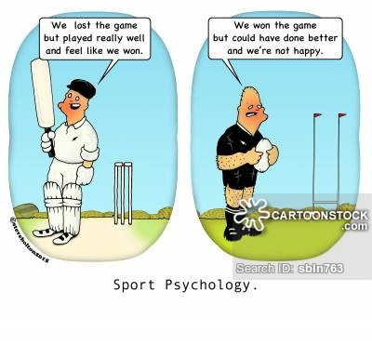
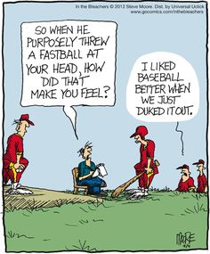
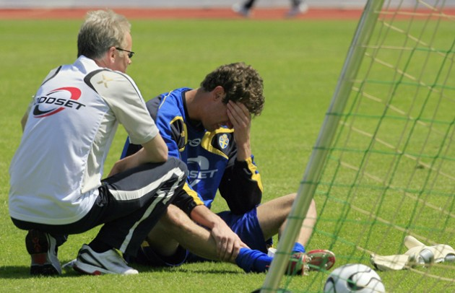
B.1.5 Evaluate the issues in personality research and sports performance.
How might understanding of personality be helpful in sports?

Slide 21
B.2.1 Define the term motivation.
Motivation is “the internal mechanisms and external stimuli which arouse and direct our behavior”
(Sage, 1974).

Slide 22
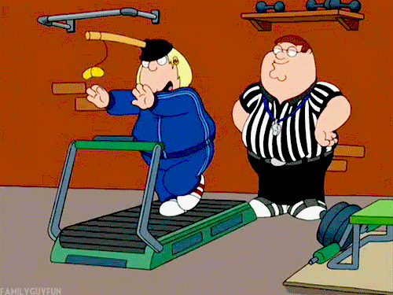
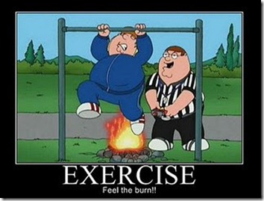
B.2.2 Outline the types of motivation.
Intrinsic motivation is when you do something simply because you enjoy it.
By comparison,
Extrinsic motivation refers to doing something for a reward or to avoid a negative consequence

Slide 23
B.2.2 Outline the types of motivation.
What are some of the intrinsic things that motivate you? In school? Work? Sports?
What are some extrinsic things that motivate you? In school? Work? Sports?

Slide 24

B.2.2 Outline the types of motivation.
Extrinsic motivation examples would be money, bonuses, nice cars, expensive houses,
high grades in school, gold medals for athletics, etc.
http://www.academia.edu/1323999/The_Difference_Between_Extrinsic_and_Intrinsic_Motivation

Slide 25
B.2.2 Outline the types of motivation.
Intrinsic motivation is the opposite. You
get paid for doing what you truly enjoy doing, nice cars and houses don’t motivate you as much as
your joy in work, learning, and the things that truly motivate you internally
http://www.academia.edu/1323999/The_Difference_Between_Extrinsic_and_Intrinsic_Motivation

Slide 26
B.2.3 Discuss the issues associated with the use of intrinsic and extrinsic motivators in sports and exercise.
.
Extrinsic rewards influence intrinsic motivation. How?
Extrinsic rewards seen as controlling of behavior.

Slide 27
B.2.3 Discuss the issues associated with the use of intrinsic and extrinsic motivators in sports and exercise.
.
Extrinsic rewards providing information about their level of performance.
Extrinsic rewards will enhance intrinsic motivation when the reward provides positive information with regard to the performer’s level of competence.

Slide 28
B.2.3 Discuss the issues associated with the use of intrinsic and extrinsic motivators in sports and exercise.
https://www.youtube.com/watch?v=4IGjH9kQHwE

Slide 29
B.2.4 Describe Atkinson’s model of Achievement Motivation.
Motivation is a balance between the motive to achieve success and the motive to avoid failure.
In sports, athletes enter with an approach-avoidance conflict. That is, they are motivated by success but also by the fear of failure.

Slide 30
B.2.4 Describe Atkinson’s model of Achievement Motivation.
Achievement motivation =
The desire to succeed – The fear of failure

Slide 31
B.2.4 Describe Atkinson’s model of Achievement Motivation.
Some athletes the desire to succeed is greater than the fear of failure. They are said to be high in achievement motivation
Some athletes the fear of failure is greater than the desire for success. They are said to be low in achievement motivation

Slide 32
B.2.4 Describe Atkinson’s model of Achievement Motivation.
High Achievers
Select challenging tasks
Display a high level of effort
Continue to try hard in difficult situations
Focus on the pride of success

Slide 33
B.2.4 Describe Atkinson’s model of Achievement Motivation.
Low Achievers
Avoid challenging activities
Exert less effort when they take part
Exert less persistence when they take part
Focus on the shame of failure

Slide 34
B.2.5 Outline Goal Orientation Theory
States that individuals have either “task oriented” or “ego oriented” goals
Task oriented people focus on mastery of a task
Ego oriented people on being superior to others and winning competitions

Slide 35
Task vs. Ego orientation can affect behaviors:
In task orientation, ego is irrelevant. Subjects are more likely to have positive experience, show greater effort, choose difficult tasks and retain interest in the activity
Ego oriented people are only likely to persevere and give maximum effort if they perceive their ability to be high. If they lose or perceive their ability to be low they may not continue.
TAKE THE “TEOSQ” –Task and Ego Orientation in Sport Questionaire –pg. 239

Slide 36
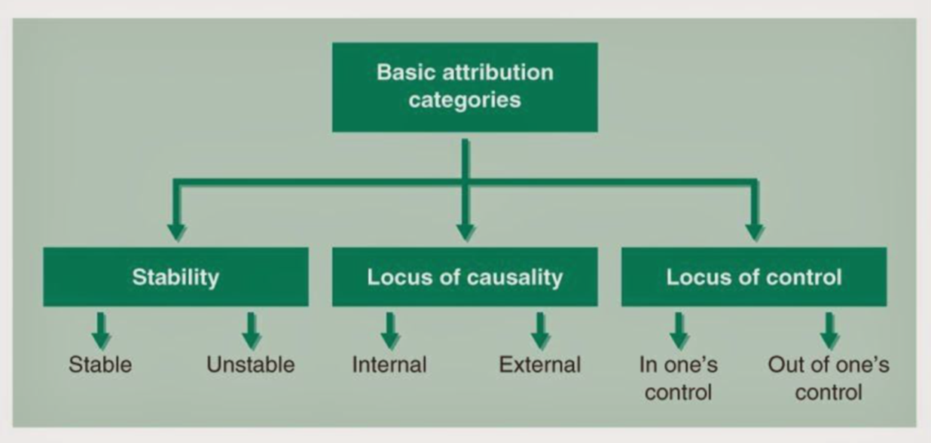
B.2.6 Describe Attribution Theory and its application to sport and exercise.
Attributions- the reasons people use to explain their successes and failures
Attributions can be classified using the following system of 3 loci:
Locus of
Locus of

Slide 37
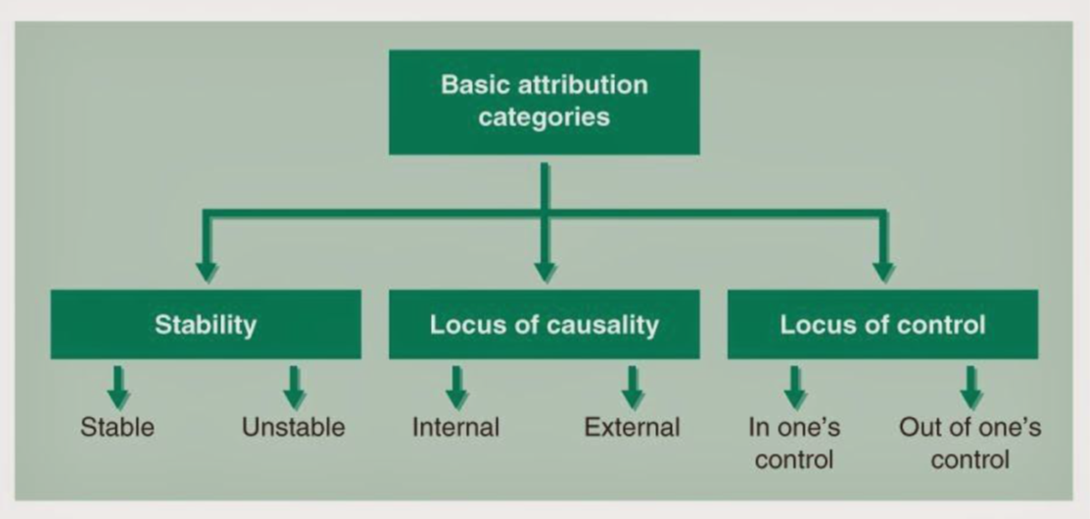
Locus of
luck or chance
Effort or strategy
Quality of opponent
Weather, equipment malfunction
ability
Effort or strategy

Slide 38
B.2.6 Describe Attribution Theory and its application to sport and exercise.
“Self Serving Bias”-
Losing or failing= we tend to attribute to things out of our control (external)
Winning and achieving-tend to explain due to internal reasons

Slide 39
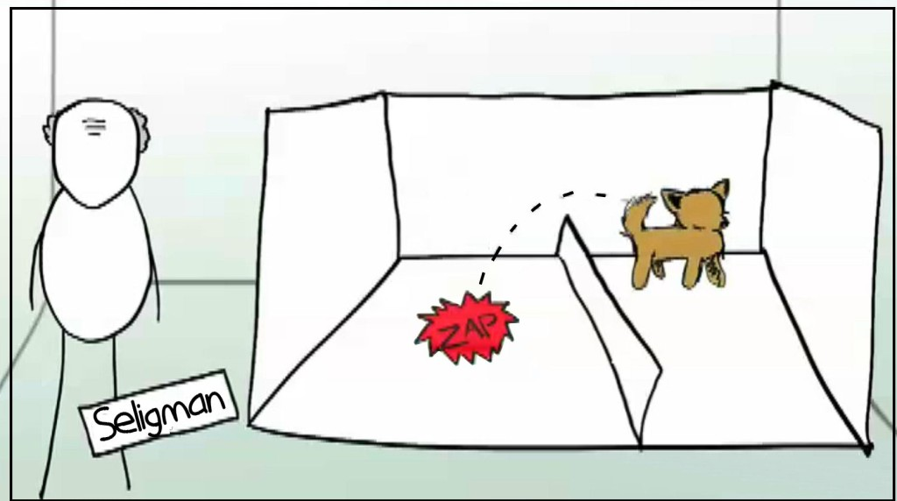
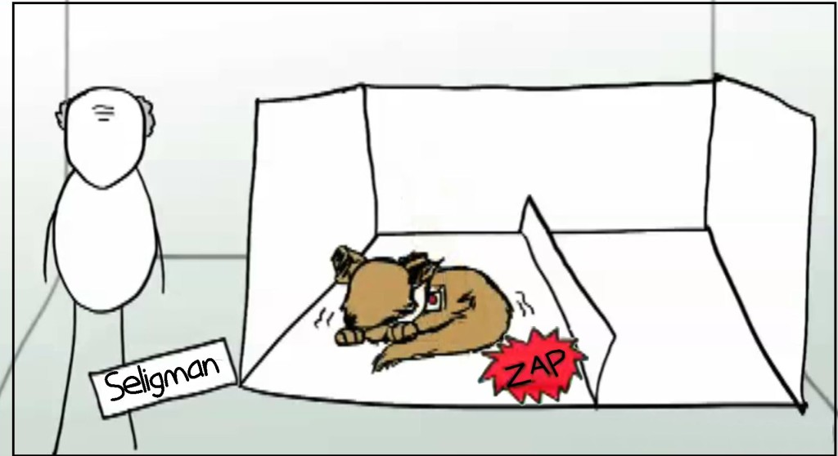
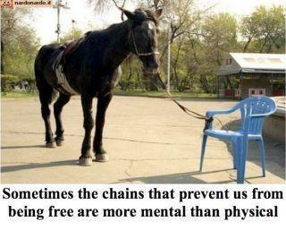
B.2.6 Describe Attribution Theory and its application to sport and exercise.
“Learned Helplessness”

Slide 40
Psychology of Sports
Review of motivation
https://www.youtube.com/watch?v=SE4IpVF1soo
https://www.youtube.com/watch?v=1akg5srwmTQ

Slide 41
Visualization
http://www.youtube.com/watch?v=vD06AfbmFlY

Slide 42


B.3.1 Define the term arousal.
State or physiological alertness or readiness. Ranges from sleep-like state to excessive excitement or even panic.

Slide 43

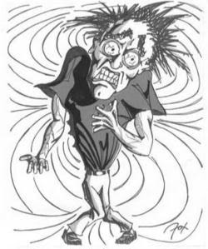
B.3.1 Define the term arousal.
NEGATIVE arousal = Anxiety
Cognitive Anxiety= Worries and negative thoughts difficult to control
Somatic Anxiety= Physical signals from the body that tell you you are anxious

Slide 44
B.3.2 Describe the theoretical approaches to arousal.
Drive Reduction Theory
Drive reduction theory says that humans are motivated to reduce the state of tension caused when certain biological needs are not satisfied. This theory helps explain behaviors that have strong biological components.
Example might be you are driven to drink a glass of water to reduce your sensation of thirst.
https://www.boundless.com

Slide 45
B.3.2 Describe the theoretical approaches to arousal.
Drive Reduction Theory
Discuss with you table some examples of drive reduction theory
An example of Drive not being reduced
.
https://www.youtube.com/watch?v=1x9W70LJKVw
https://www.boundless.com

Slide 46
B.3.2 Describe the theoretical approaches to arousal.
Inverted-U hypothesis
For complex tasks there was an optimal level of arousal above and below which performance levels would decrease.
The theory is that as arousal is increased then performance improves but only up to a certain point (top of the inverted U). If the athlete's arousal is increased beyond this point then performance diminishes.
https://www.boundless.com

Slide 47
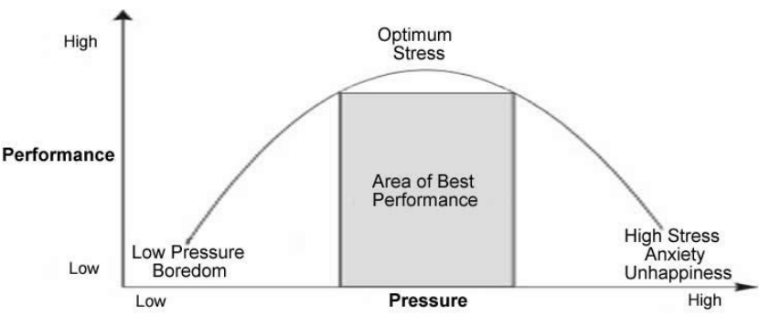
Inverted-U hypothesis
http://www.mindtools.com/pages/article/inverted-u.htm

Slide 48
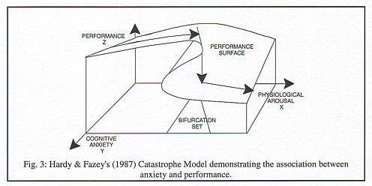
B.3.2 Describe the theoretical approaches to arousal.
Catastrophe theory.
Sometimes known as choking. The pressure seems insurmountable and an athlete will fall victim to what sports psychologists call the catastrophe theory.
https://www.boundless.com

Slide 49
B.3.2 Describe the theoretical approaches to arousal.
Catastrophe theory.
The interaction between physiological arousal and cognitive anxiety.
Why the behavior occurs it not yet known.
https://www.boundless.com

Slide 50
B.4.1 Discuss psychological skills training (PST).
Psychological skills training (PST)
Refers to the systematic and consistent practice of mental or psychological skills.
Include the following issues.
https://www.boundless.com

Slide 51
B.4.1 Discuss psychological skills training (PST).
PST: (i) is not just for elite athletes
(ii) is not just for problem athletes
(iii) does not provide quick fix solutions.
https://www.boundless.com

Slide 52
B.4.1 Discuss psychological skills training (PST).
Psychological Skills Training (PST) is an individually designed combination of methods selected to attain psychological skill needs.
There is no single idyllic PST package, each program must be individualized based on the psychological state of the individual and, the sport.
http://www.brianmac.co.uk/articles/article001.htm

Slide 53
B.4.1 Discuss psychological skills training (PST).
To assemble a successful PST program it is important to distinguish between PST skills and PST methods. PST skills are the psychological qualities or attributes that need to be developed (i.e. confidence, concentration), the PST method is the tool that will be used to help improve the PST skill (Calmels et al. 2003).
http://www.brianmac.co.uk/articles/article001.htm

Slide 54
B.4.1 Discuss psychological skills training (PST).
When implementing a PST program, it is improbable that a single method will be employed by a sports psychologist. It is more effective to employ a combination of mental skills that relate to the specific sport.
http://www.brianmac.co.uk/articles/article001.htm

Slide 55
B.4.2 Outline goal setting.
Goal setting helps with motivation to the individual and also can give self confidence to the individual.
http://www.brianmac.co.uk/articles/article001.htm

Slide 56
B.4.2 Outline goal setting.
SMARTER (specific, measurable, achievable, realistic, time, evaluate, review) goals
http://www.brianmac.co.uk/articles/article001.htm

Slide 57
B.4.2 Outline goal setting.
Set a combination of outcome, performance and process goals
Process goals:
Race plan
Positive mental imagery
Quality training program
http://www.brianmac.co.uk/articles/article001.htm

Slide 58
B.4.2 Outline goal setting.
Set a combination of outcome, performance and process goals
Performance goals:
Run a race at a given time.
Keep pitch count down to 60.
Throw no interceptions
http://www.brianmac.co.uk/articles/article001.htm

Slide 59
B.4.2 Outline goal setting.
Set a combination of outcome, performance and process goals
Outcome goals
Win the game.
Beat the number one seed.
Get selected for the All-star team.
http://www.brianmac.co.uk/articles/article001.htm

Slide 60
B.4.3 Evaluate mental imagery.
SMARTER (specific, measurable, achievable, realistic, time, evaluate, review) goals
http://www.brianmac.co.uk/articles/article001.htm

