Slide 1
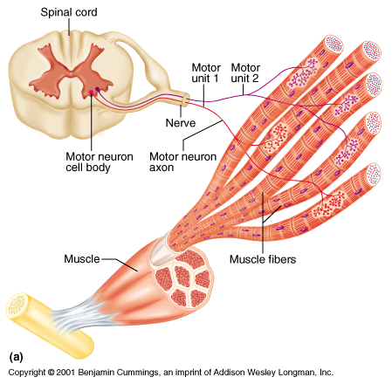
Neuromuscular Function – 4.1

Slide 2
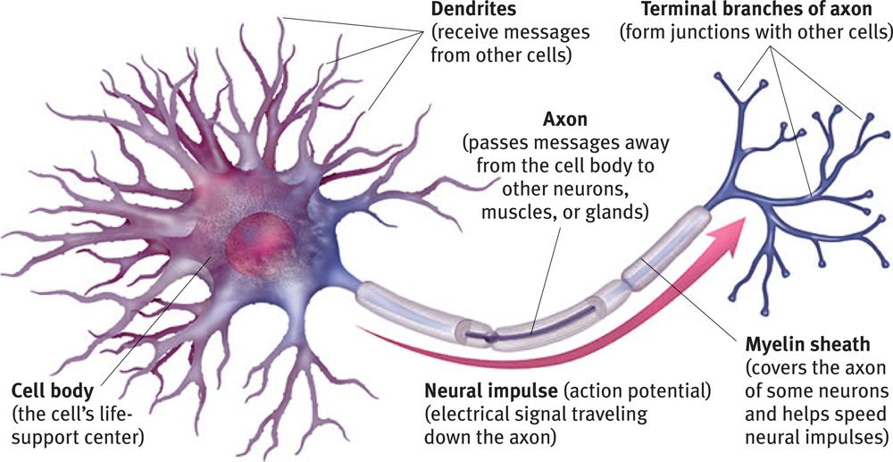
Motor Neuron-
(muscle)
(in spinal cord)
Schwann Cells- Wrap around axon insulating it with fatty myelin
Action Potential- wave of Na⁺ and K⁺ ions entering and leaving the neuron (moving electrical impulse)

Slide 3
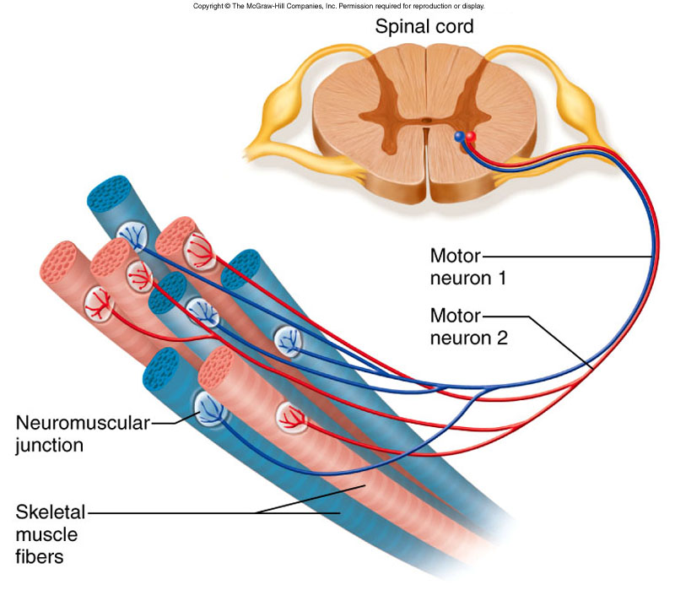
Motor Unit- a motor neuron and all of the muscle fibers it controls
Motor units may have many fibers for large movement (quad muscle)
Or few for delicate movement (fingers)
All fibers of a motor unit will contract or none at all (all or none principle)
We can control the strength of a contraction by how many motor units are recruited (graded strength principle)

Slide 4
Neuromuscular Junction- where neuron and muscle meet.
The microscopic gap between neuron and muscle = “synapse”
The neuron release the neurotransmitter acetylcholine (ACh) into the synapse
ACh binds to receptors on muscle cell membrane (sarcolemma)
If enough ACh binds, the muscle is excited
The enzyme acetylcholinesterase breaks down used Ach so it can be reabsorbed and reused by neuron.

Slide 5
3 Motor Unit Types- I, IIa, IIb
RED
RED
WHITE

Slide 6
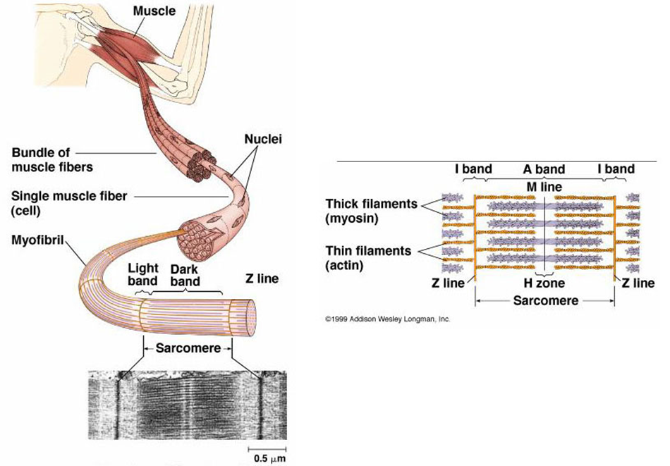
Sarcomeres-
made of thousands of
“intermeshed” thick and
thin myofilaments
Thin filaments contain
the active protein actin
Thick filaments
contain the protein myosin
Thick and thin
filaments give muscle the striated appearance
Dark bands=thick & thin filaments “the A band” –contains “H zone” in the middle (only myosin)
Light bands= only thin filament “the I band”
Ends of sarcomeres “the Z lines”

Slide 7
Contraction of a Sarcomere-
A action potential reaches the nerve/muscle synapse releases acetylcholine at neuromuscular junction
stimulation of acetylcholine receptors in muscle cell membrane causes the muscle cell to release Ca++ ions from the sarcoplasmic reticulum (SR) into myofibrils.
the Ca++ causes troponin and tropomyosin proteins to shift allowing myosin to bind to actin in the thin and thick filaments of the sarcomere
myosin tugs on actin many times per second causing the sarcomeres to shorten
- ATP is needed for each “power stroke” and is needed for Myosin to release from actin

Slide 8
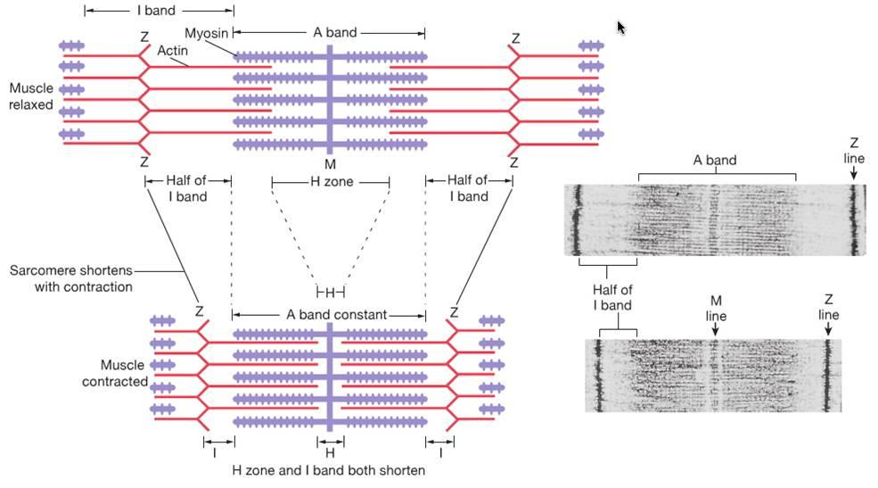
Contracted Sarcomere
Z lines are pulled closer together
I bands get narrower
H zone disappears
A band=no change

Slide 9
Relaxation of Muscle
-When nerve impulses are over, Ach is removed by acetylcholinesterase
-Ca++ is pumped back into SR
-actin is again blocked from myosin
-thin and thick filaments slide back to their original position
Animation of Sarcomere contraction and relaxation

Slide 10
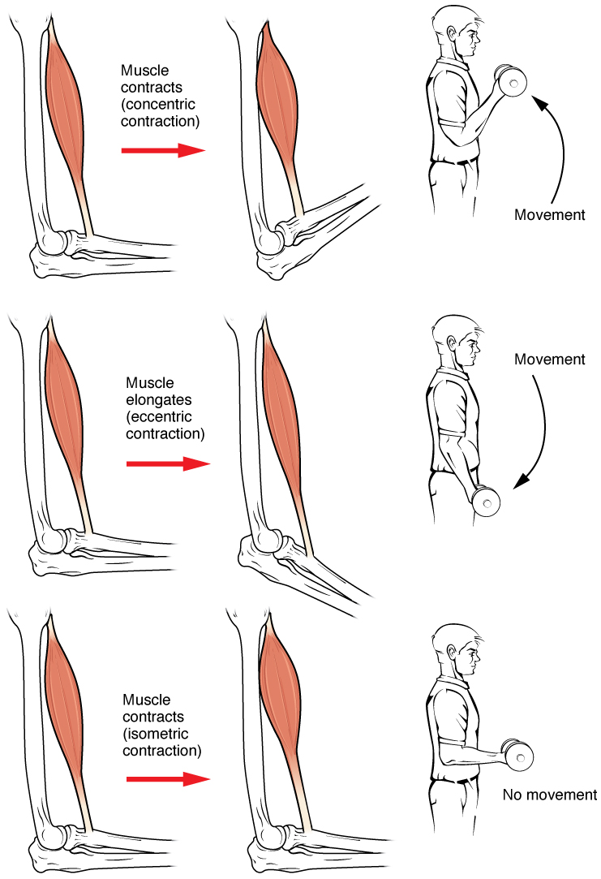
Types of Contractions-
Concentric- Muscle contracts and shortens (muscle force greater than resistance)
Isometric- Muscle contracts but there is no movement (forces are equal)
Eccentric- Muscle contracts but actually gets longer (muscle force is less than resistance)

Slide 11
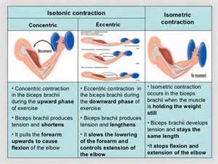
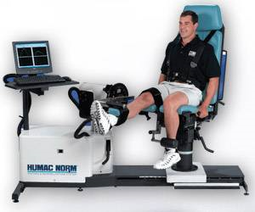
Isotonic- Meaning “same tension” when there is constant force throughout movement. Concentric and eccentric movements are defined this way
Misleading though because of change in joint angles
Isokinetic motion- constant speed of moving body part throughout a motion. Not common in sports. Used by therapists (with aid of equipment) during rehab to avoid injury

Slide 12
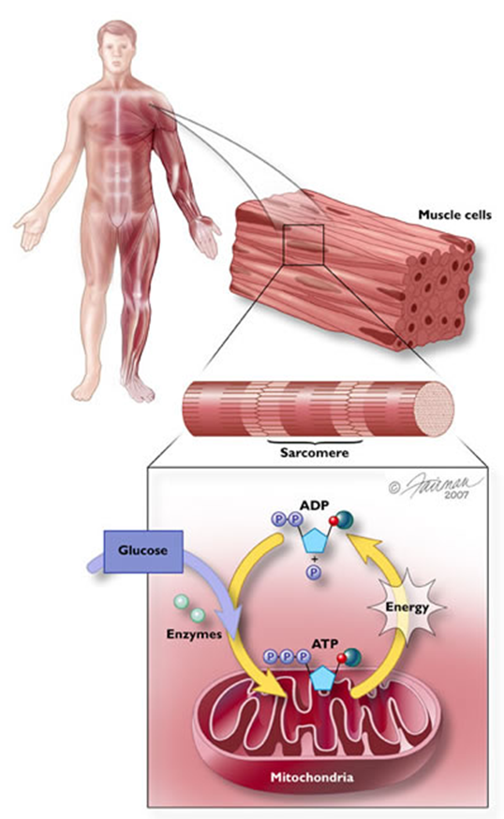
Muscle Fatigue
2 main contributing factors:
1.- depletion of energy molecules required for contraction:
ATP
Glucose/Glycogen
phosophocreatine
2.- buildup of byproducts of contraction:
Lactic Acid
blocks the binding site for Ca⁺⁺ ions
Ammonia (NH₄)
dulls nerve activity in central nervous system
Heat
also impairs nerve function

