Slide 1
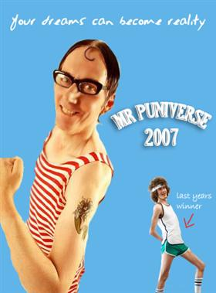
Muscular System

Slide 2
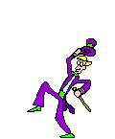
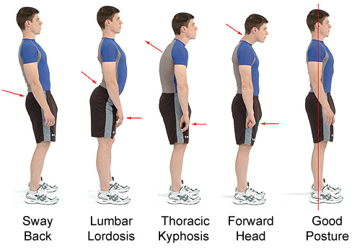
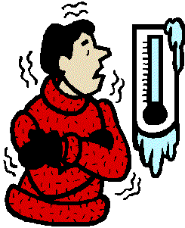
General Functions:
Movement
Posture
Heat Production
(shivering)

Slide 3
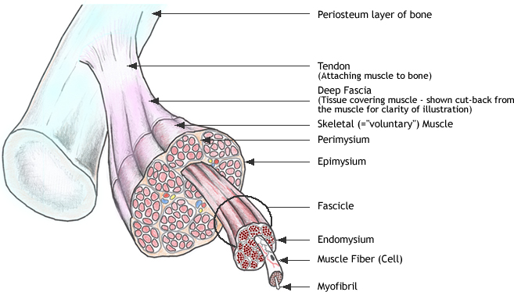
Levels of Muscle Structure
Muscle
↓
Fascicles
↓
Muscle Fibers (cells)
↓
Myofibrils
↓
Sarcomeres
↓
Myofilaments (actin and myosin
proteins)

Slide 4
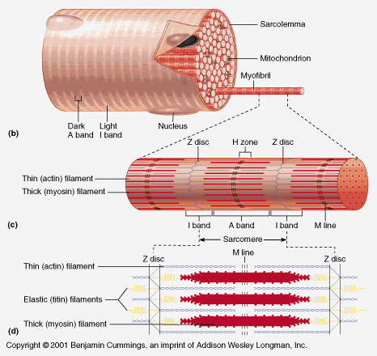
Microscopic anatomy of Striated Muscle:
- A muscle cell is also often called a muscle fiber – VERY long, VERY thin, multinucleate MANY mitochondria
- a muscle fiber has many tiny parallel fibers called myofibrils
- a myofibril is a long lineup of many contractile units called sarcomeres
a muscle fiber (muscle cell)

Slide 5
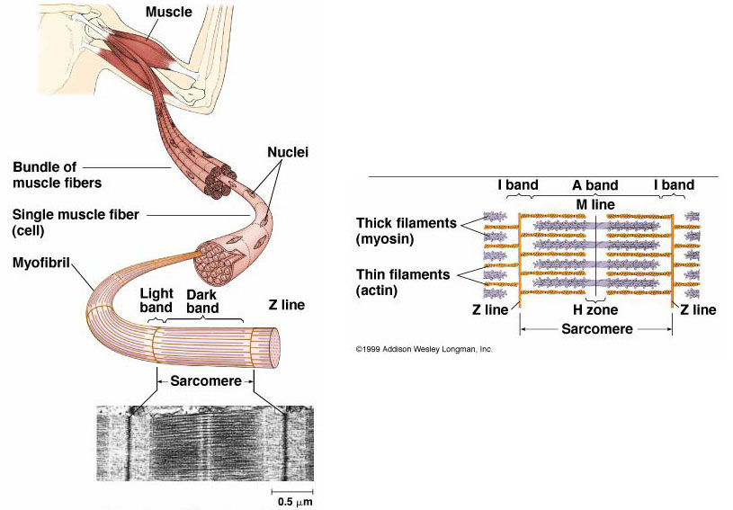
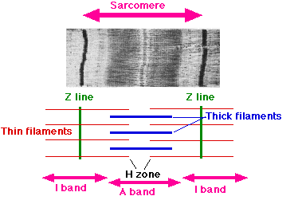
Sarcomeres
made of thousands of
“intermeshed” thick and
thin myofilaments
Thin filaments contain
the active protein actin
Thick filaments
contain the protein myosin
Thick and thin
filaments give muscle the striated appearance
Dark bands=thick & thin filaments “the A band”
Light bands= only thin filament “the I band”
Ends of sarcomeres “the Z line”

Slide 6
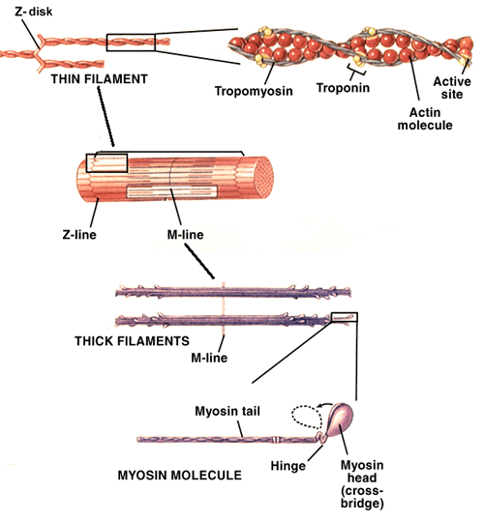
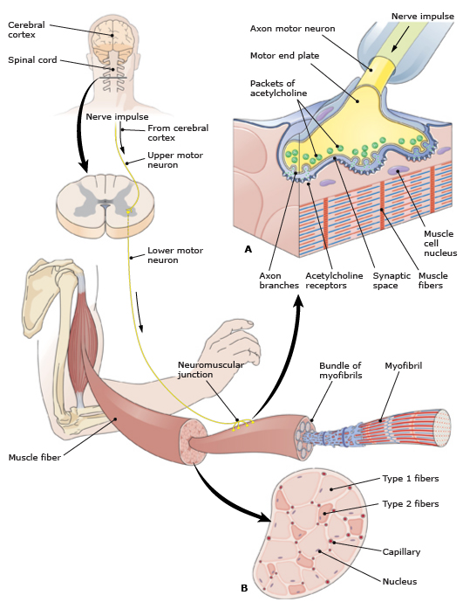

Slide 7
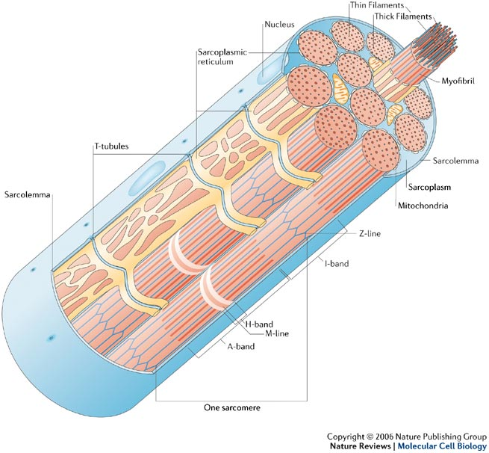

Slide 8
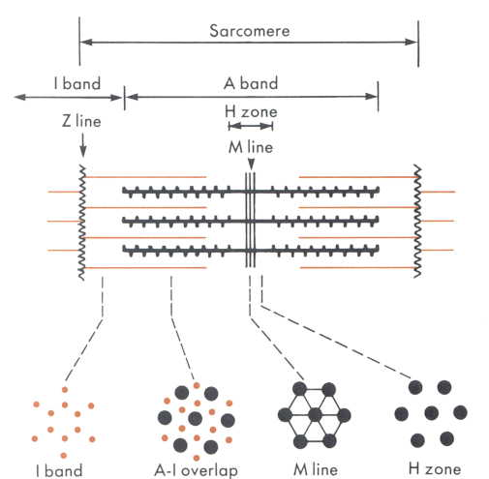
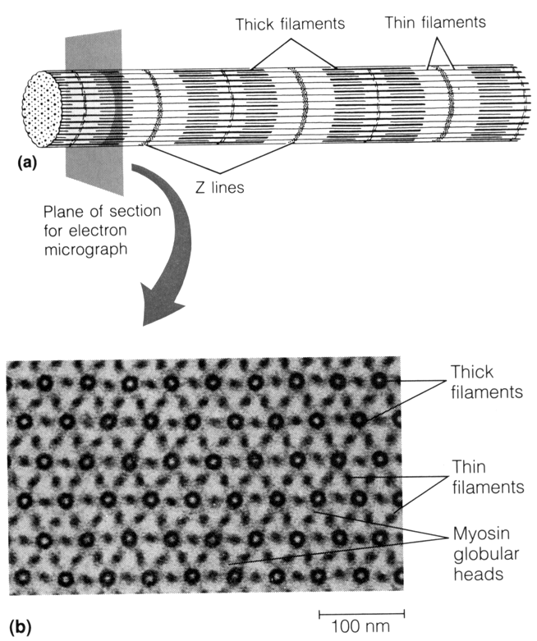
Sarcomere cross-sectional view

Slide 9
Contraction of a Sarcomere:
a NERVE IMPULSE at the nerve/muscle synapse releases acetylcholine at neuromuscular junction
stimulation of acetylcholine receptors in muscle cell membrane causes the muscle cell to release Ca++ ions from the sarcoplasmic reticulum (SR)
the Ca++ causes troponin and tropomyosin proteins to shift allowing myosin to bind to actin in the thin and thick filaments
myosin tugs on actin many times per second causing the sarcomeres to shorten
- this requires energy from ATP that is present in muscle cell
(From cell respiration: Glucose + oxygen→ ATP + CO₂)

Slide 10
Relaxation
-When nerve impulses are over, Ca++ is pumped back into SR
-actin & myosin are no longer bound together
-thin and thick filaments slide back to their original position
Animation of Sarcomere contraction and relaxation

Slide 11
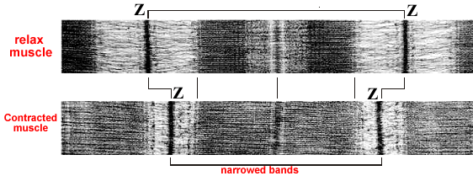

Slide 12
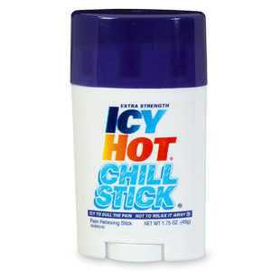
Respiration in Muscle Cells-
Aerobic (presence of plenty of oxygen):
1 Glucose → 38ATP + CO₂
ATP= the major energy currency of the cell, used in most energy consuming activities of the cell
Anaerobic (no oxygen):
1 Glucose → 2ATP + lactic acid (ouchie!)
very inefficient (only 2 ATP) and lactic acid causes muscle soreness

Slide 13
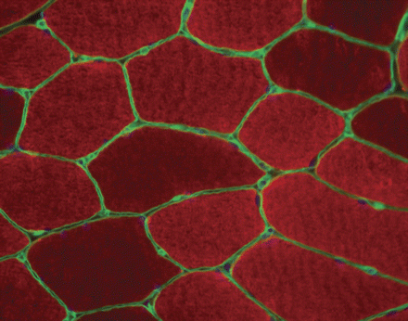
Types of Skeletal Muscle Fibers-
Slow Twitch- “red fibers”
-contain myoglobin for oxygen storage
-used for aerobic endurance type activities
Cross-section of muscle fibers

Slide 14
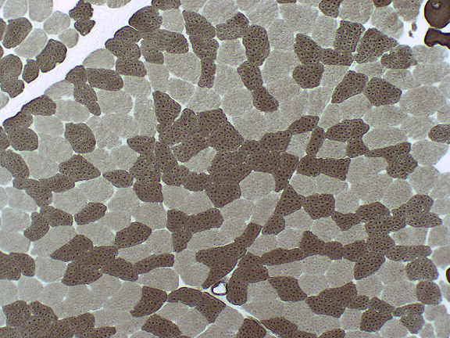
Fast Twitch Muscle- “white fibers”
-very little myoglobin
-for short bursts of power
Intermediate Muscle-
- contain both red and white fibers
- most common in the body
White fibers
red fibers

Slide 15
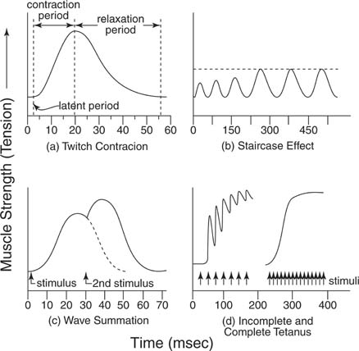
Muscle Contractions-
All or none principle- when a single fiber (cell) is stimulated to threshold, it will contract with max force possible
Contractions can be graphed in a myograph – (see examples)

Slide 16
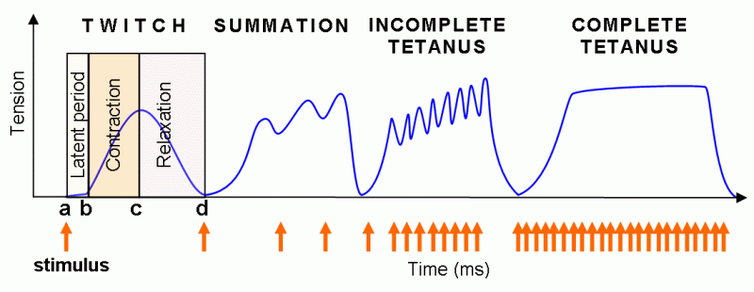
Twitch: single contractions only last a fraction of a second!
Treppe: “staircase effect” contractions get stronger as muscle warms up.
Tetanus: stimuli are rapid enough to sustain a contraction may be incomplete (quivering) or complete.
Fatigue: muscle not able to respond to ANY stimulus (no ATP)
Muscle tone: low level contraction in awake person (maintains
posture)

Slide 17
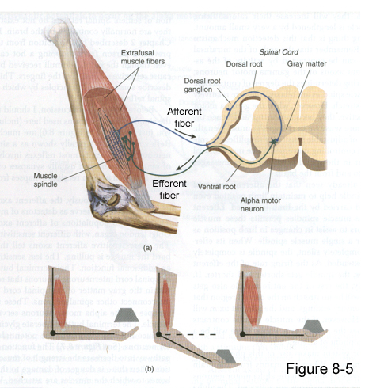
Graded Strength Principle-
As you lift a heavy object, more and more muscle fibers are “recruited” to resist stretching of the muscle until the load is matched.
-achieved by stretch
receptors in the muscle
(negative feedback loop)
- prevents wasting energy
and ensures smooth or
graceful movement

Slide 18
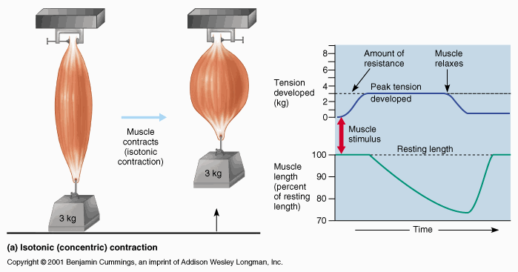
Isotonic vs. Isometric contractions-
Isotonic- muscle tension constant & muscle shortens (movement)

Slide 19
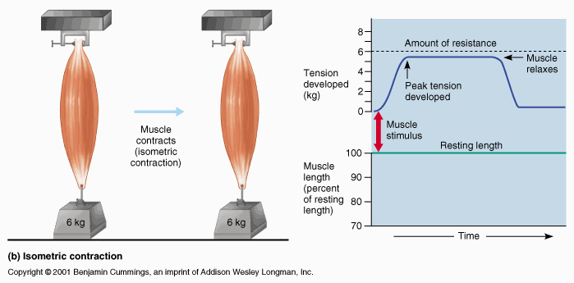
Isometric- tension increases but muscle can’t shorten (load too heavy)

Slide 20
Muscle Fatigue
2 main contributing factors:
1.- depletion of energy molecules required for contraction:
ATP
Glucose/Glycogen
phosophocreatine
2.- buildup of byproducts of contraction:
Lactic Acid
blocks the binding site for Ca⁺⁺ ions
Ammonia (NH₄)
dulls nerve activity in central nervous system
Heat
also impairs nerve function

Slide 21
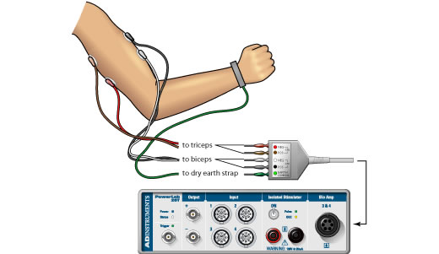
Electromyograph (EMG)
Measures electrical activity in the muscle rather than force
movement of ions (Na⁺, K⁺, Cl⁻, Ca⁺⁺) across cell membranes causes electrical current
May be be done with surface electrodes or thin needles inserted into the muscle

Slide 22
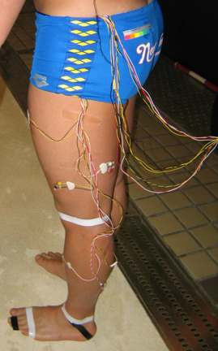
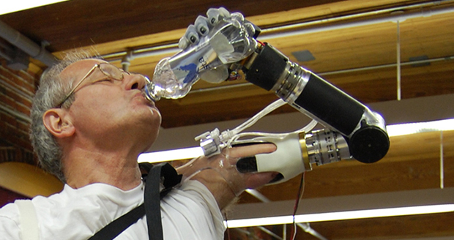
EMG is a tool for diagnosing neuromuscular disorders or studying kinesiology
EMG signals can be used to operate prosthetic limbs or even other electronic devices like computers

Slide 23
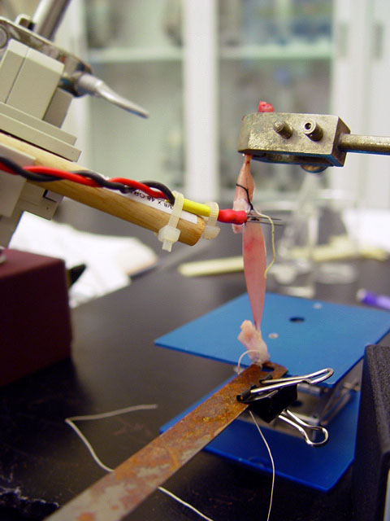
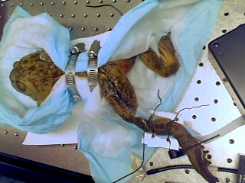
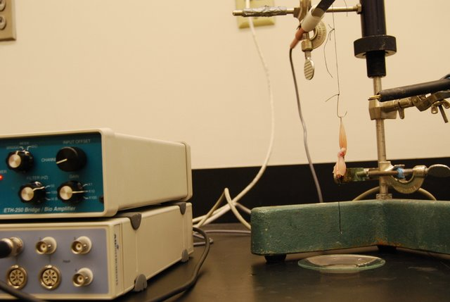

Slide 24
