Slide 1
Joints
(Articulations)

Slide 2
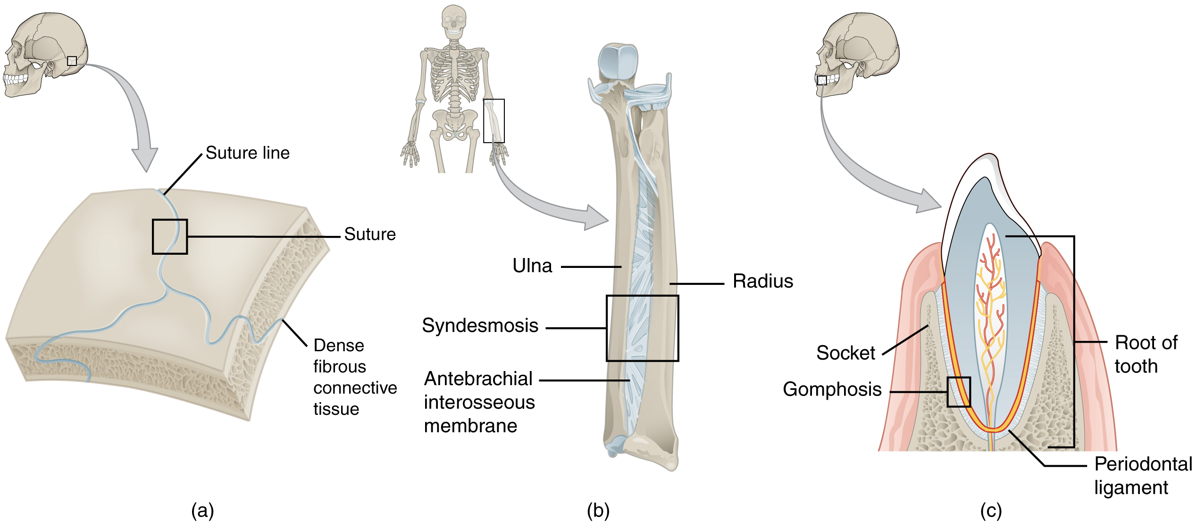
3 Main Types of Joints
Fibrous – Edges of 2 bones tightly joined by connective fibers -No movement!
3 kinds:

Slide 3
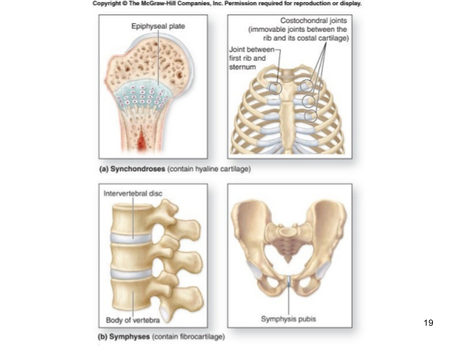
Cartilaginous Joints- Bones connected only by cartilage – SLIGHT movement.

Slide 4
Synovial Joints- Freely moveable- There is a fluid filled synovial capsule between bones. Bones connected by ligaments.

Slide 5
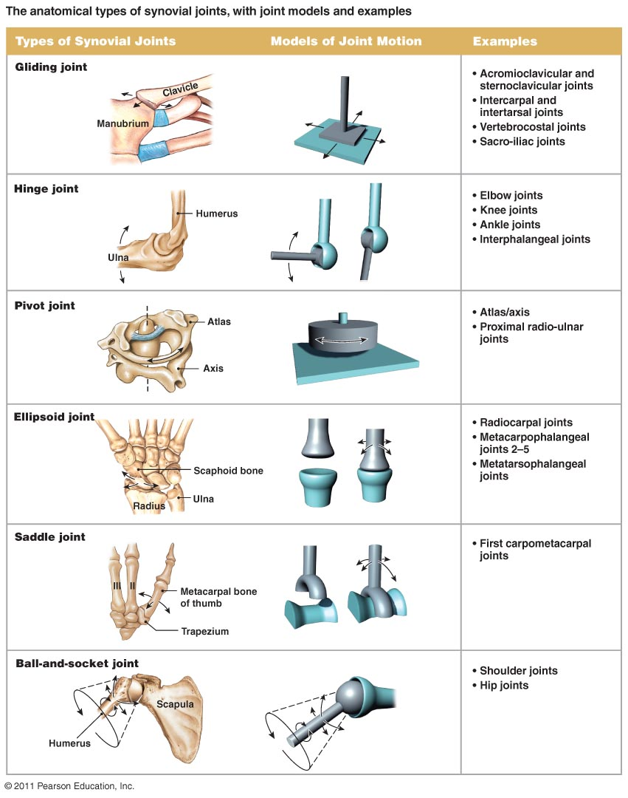
There are 6 types of synovial joints – See handout

Slide 6
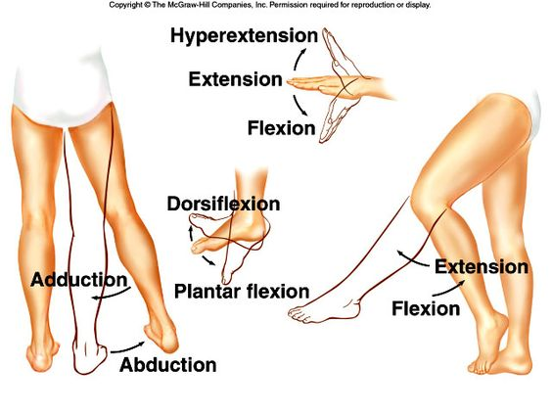
Skeletal Movements-
Movement relative to frontal plane:
Flexion= decreasing the angle of a joint
Extension= increasing angle of a joint (opposite of flexion)
Hyperextension= extending beyond normal range
Dorsiflexion= bending ankle to point toes up
Plantar flexion= bending ankle to point toes down

Slide 7
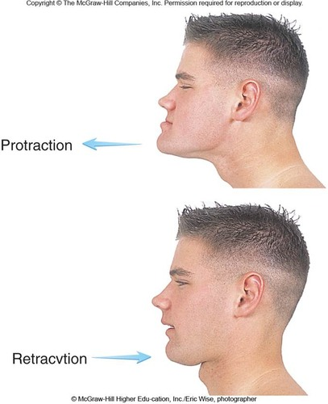
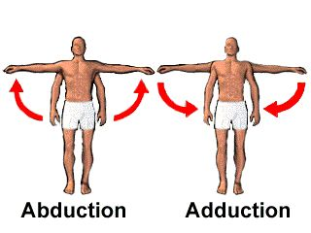
Protraction= moving appendage outward horizontally
Retraction= moving appendage inward horizontally
Movement relative to sagittal plane:
Abduction= moving appendage away from midsagittal plane
Adduction= moving appendage toward midsagittal plane

Slide 8
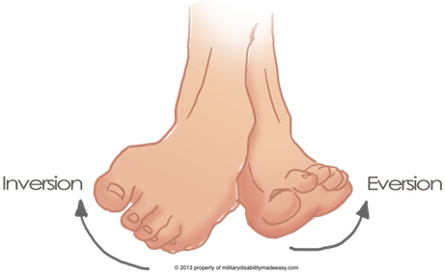
Inversion= turning ankle inward (sole towards midsagittal)
Eversion= turning ankle outward (sole away from midsagittal)

Slide 9
Circular movements:
Circumduction= circular sweep of appendage (making cone shape)
Rotation= pivoting a bone on its axis
Pronation= turning palm down
Supination= turning palm up
Other:
Elevation= raising a part
Depression= lowering a part

