Slide 1
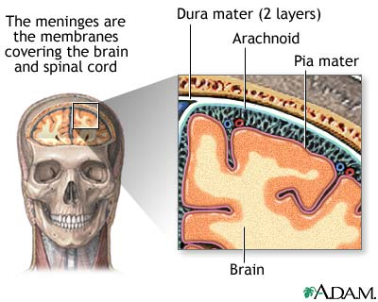
Meninges Dura mater -tough leathery outer covering
(membranes Arachnoid -web like middle layer (vascular)
or coverings) Pia Mater -inner most layer (very thin)

Slide 2
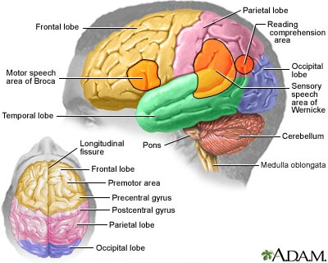
Cerebrum= (higher level processes)
Hemispheres -R&L halves
Long. Fissure -crack separating hemispheres

Slide 3
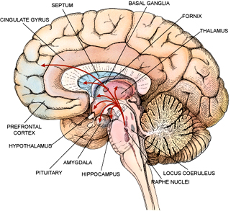
Corpus callosum -dense white matter connecting hemispheres

Slide 4
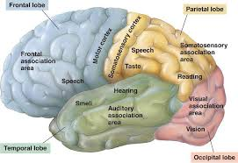
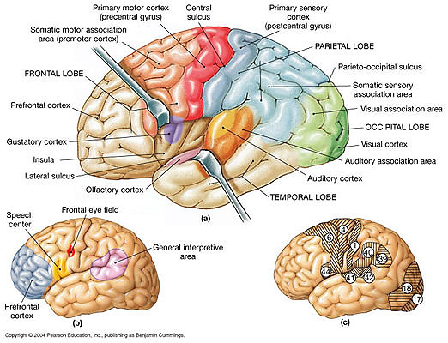
Insula
frontal lobe -thought, memory, decisions
parietal lobe -hearing, sensory speech
occipital lobe -visual
temporal lobe -hearing
Insula (behind temporal lobe) -motor speech

Slide 5
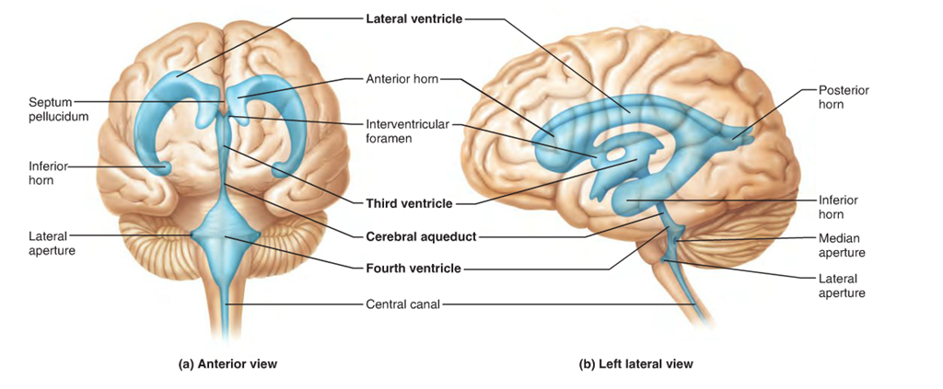
lateral Ventricles -large central cavities containing CSF. CSF is produced here by the choroid plexus
septum pellucidum – membrane separating R&L lateral ventricles

Slide 6
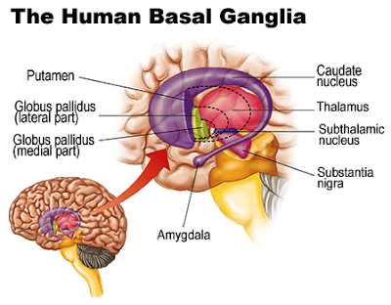
caudate nucleus- learning, various other functions???

Slide 7
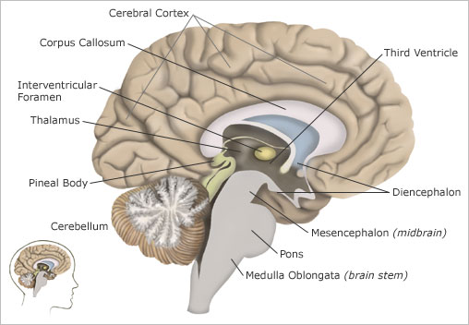
Cerebellum (motor center) arbor vitae - “tree of life” white matter sending motor signals

Slide 8
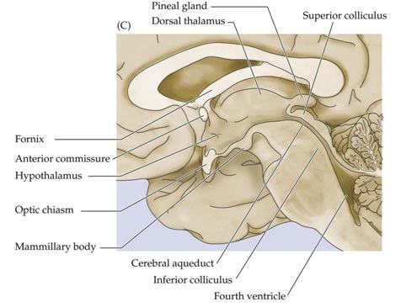
Diencephalon:
optic chiasma - crossing of R&L optic nerves
Infundibulum -connects pituitary gland to hypothalamus of the brain
Thalamus -“switchboard” or processing center
(integrates many processes)
Pineal gland -“clock” – sleep patterns (vestigial)

Slide 9
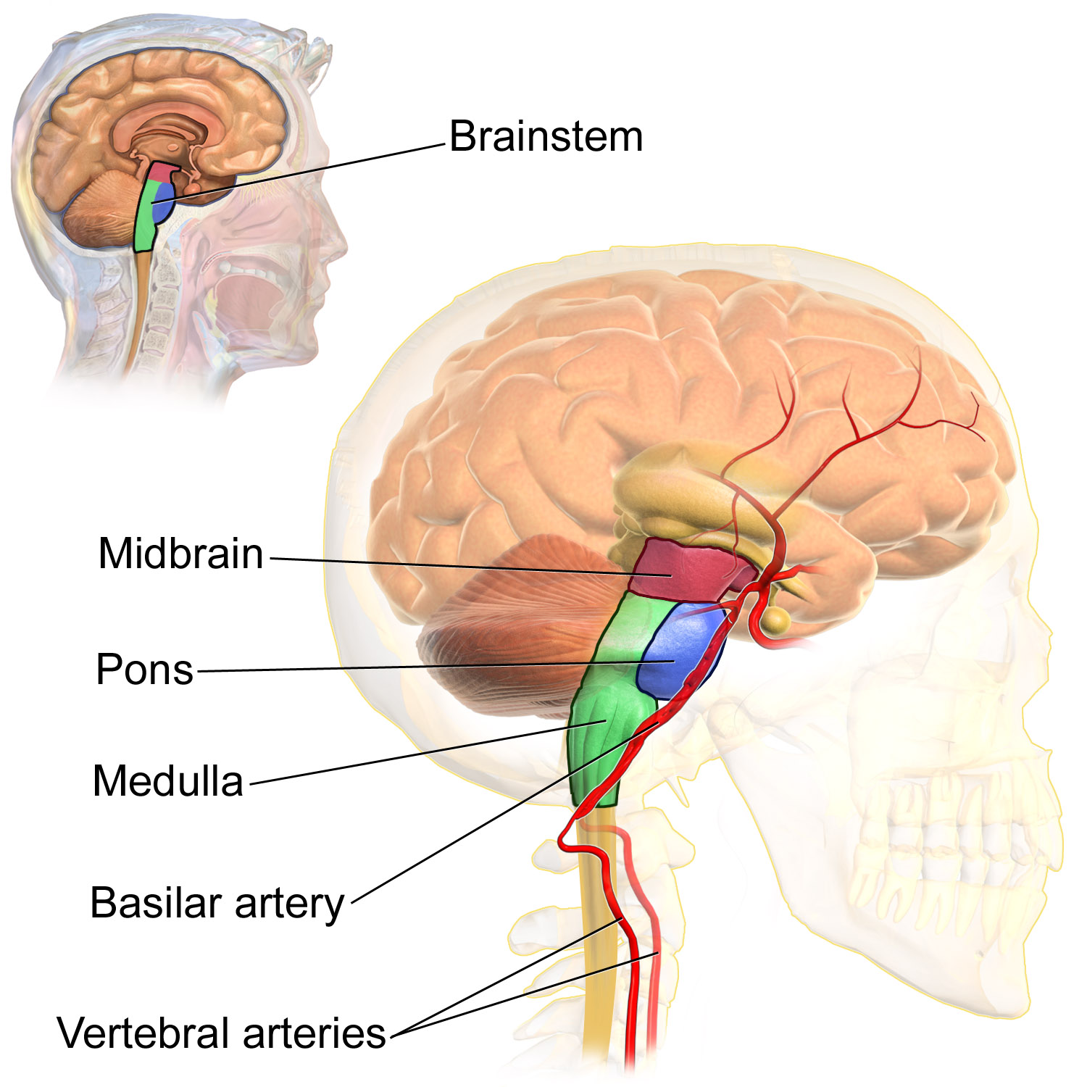
Midbrain part of brainstem - mostly motor
Pons relay between cerebrum and cerebellum
Medulla “primitive” brain – breathing, heartrate – “vital center”

Slide 10
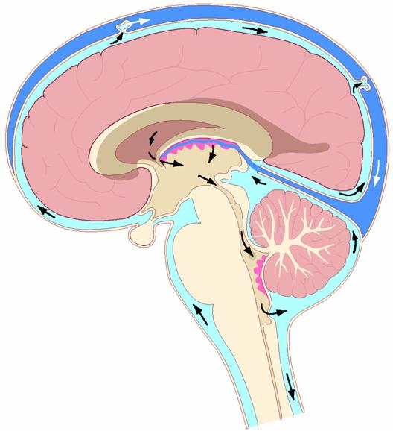

Slide 11
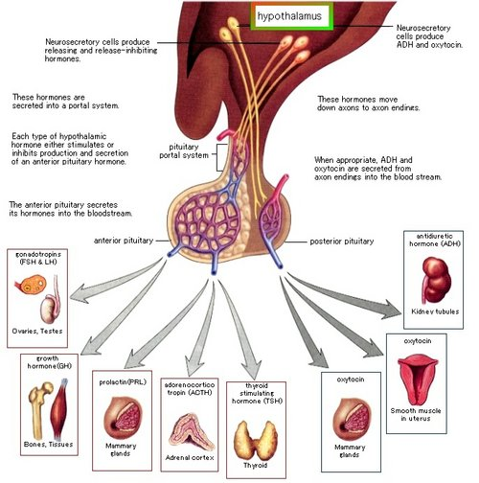
Pituitary gland endocrine gland – secretes hormones that control the activity of many other endocrine glands -“the master gland”

Slide 12
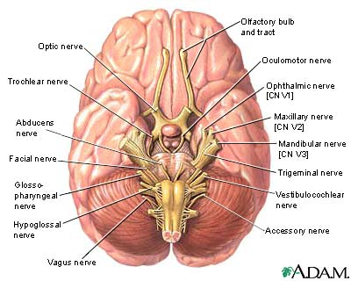

Slide 13
