Slide 1
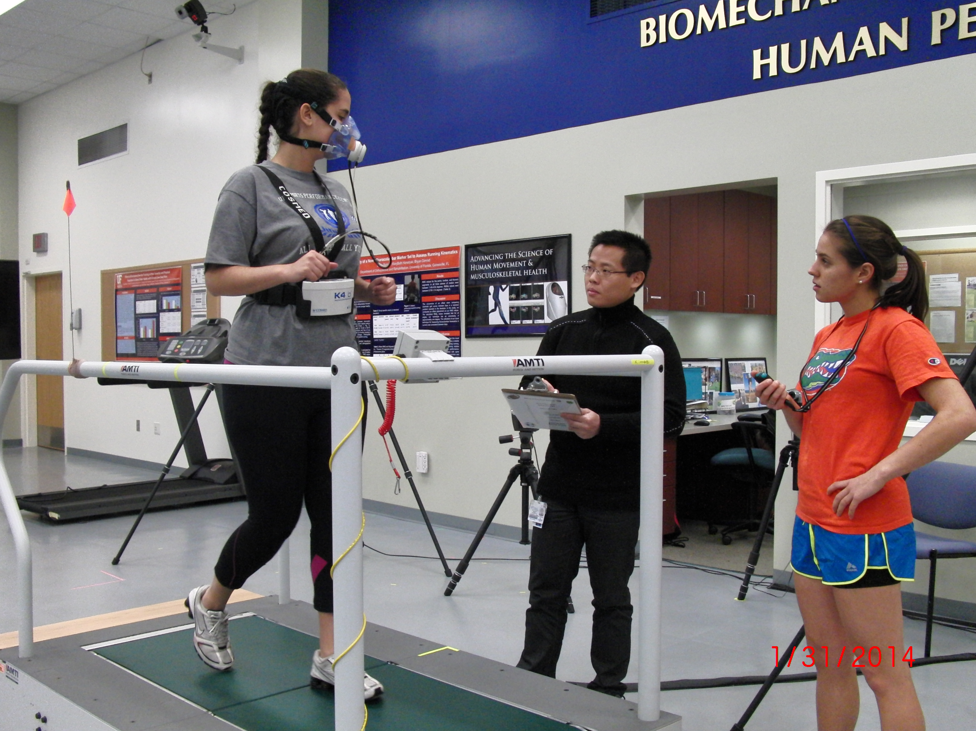
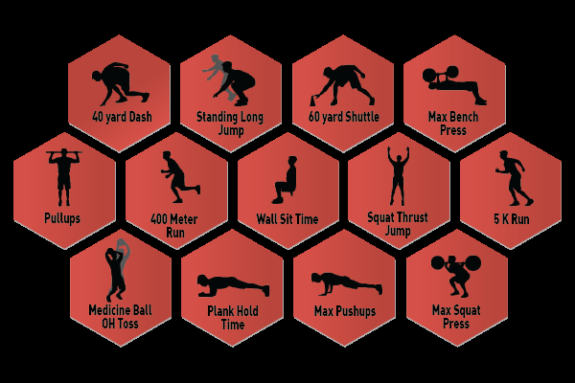
6.2- SEHS- Study Design

Slide 2
6.2.1-Fitness Tests must have the following attributes:
Specificity- is the test specific to the skill needed in a particular sport?
Accuracy- are measuring devices or equipment of sufficient quality?
Reliability- will the test produce similar results from one occasion to the next?
Validity- Doesthe test actually measure what it’s supposed to?

Slide 3
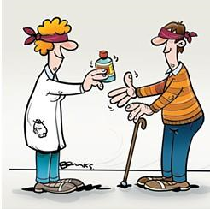
6.2.2- Proper Study Design is Vital in SEHS
Control Group- Those not receiving any treatment or may receive a placebo, a harmless substance that will not effect performance but subjects will be unsure of whether they received treatment or not.
Blind test= subjects do not know if they received treatment
Double Blind test= neither subjects nor experimenters know who gets treatment.
Randomization- subjects are selected for either control or experimental groups by random selection

Slide 4
6.2.3-PAR-Q
All subjects must answer NO to ALL questions on the “Physical Activity Readiness Questionaire before taking part in fitness testing!
6.2.4-Testing Types
Lab or Field- Pros and Cons of Each?
Maximal or Sub-Maximal? (i.e.- max out vs. more moderate) – Pros and Cons?

Slide 5
6.3- SEHS- Components of PHYSICAL Fitness
There are 2 categories of Fitness:
Health Related Fitness
Determines ability to live normal and healthy life
Determine a persons ability to meet the physical demands of a sport
Performance (Skill) Related Fitness*
Determines success on a specific skill in a sport
*Some degree of both types of fitness are needed for success in a sport. Some performance related fitness could become health related in elderly and diseased.

Slide 6
Health Related-
CARDIO-RESPIRATORY FITNESS- the ability to provide and sustain energy aerobically (aerobic capacity)
BODY COMPOSITION- Body fat vs. Lean
Fat is either essential (in organs) or stored (adipose reserves)
Lean is muscle, water, and bone (bone density is important!)
STRENGTH- the maximum force that can be developed in a muscle or group of muscles in a single maximal contraction.
MUSCULAR ENDURANCE- ability of a muscle group to keep working at the desired level of effort for as long as the situation demands.
FLEXIBILITY-the range of movement at a joint.

Slide 7
SKILL RELATED-
AGILITY- the ability to move and change direction and position of the body quickly and effectively while under control.
BALANCE- maintenance of the centre of mass over the base of support. May be static or dynamic (moving).
COORDINATION- interaction motor and nervous systems and is the ability to perform motor tasks accurately and effectively.
POWER- combination of strength and quickess. Strong as possible as quickly as possible
REACTION TIME- the time taken to initiate a response to a given stimulus.
SPEED- the maximum rate that a person can move over a specific distance.

Slide 8
6.4.1 Describe the essential elements of a general training program
Warm Up:
A warm up should prepare the body for exercise. It can prevent injury and muscle soreness and has the following physiological benefits :
Release of adrenaline: increased speed of oxygen delivery to the muscles.
Decreased viscosity of blood due to increase in muscle temperature.
Increased muscle temperatures which will facilitate enzyme activity and subsequent increased muscle metabolism leading to breakdown of glycogen.
Increased temperature leading to greater extensibility and elasticity of muscle fibres.
Increase speed of nerve impulse conduction.
Increase production of synovial fluid, improving efficiency of joints.

Slide 9
3 Stage Warm Up:
Step 1: Purpose to raise heart rate in order to increase body temperature and speed of oxygen delivery to the muscles. This can be achieved by performing some kind of cardiovascular exercise such as jogging.
Step 2: Now the muscle temperature has increased, the athlete can perform some mobility or stretching exercises. Static and calethenic type exercises are performed where the muscle is working over it’s full range. Push ups, lunges, grape vine and sumo squats are all examples.
Step 3: The final stage of a warm up should involve a sport-specific or skill-related component where neuromuscular mechanisms related to the activity are worked. For example, practicing serving in tennis, tumble turns in swimming or shooting baskets in basketball.

